Slide 1
Better Together
Strategy Deck: slide 1-31
Product Deck: slide 32 onwards
+
Your Logo Here
Where great technology and skilled expertise meet

Slide 2
Partnership Summary
Add your partner Tier Logo here
Camunda Partner since <X Date>
Partner Type <Services, Sales, Solution>
Partner Tier <Silver/Gold/Platinum>
Trained resources located in <GEOs, Industries>
<Certified Resources>
# client deployments
<Scope of Partnership>
<Geographies, industries and clients served>
<Services offered by the partner>
Notes:
Why Partner with Camunda? This speaks to the the strategic importance as to why the partner is investing in Camunda.
What customer value do we drive with Camunda? ROI outcomes
Why is Camunda a superior technology ?

Slide 3

Better Together
Add your partner Tier Logo here
Enterprise-grade Agentic Orchestration
Partner tagline
Camunda enables organizations to orchestrate and automate processes across people, systems, and devices to continuously overcome complexity, increase efficiency, and fully operationalize AI. Built for business and IT, Camunda’s leading orchestration and automation platform executes any process at the required speed and scale to remain competitive without compromising security, governance, or innovation. Over 700 companies across all industries, including Atlassian, ING, and Vodafone, trust Camunda with the design, orchestration, automation, and improvement of their business-critical processes to accelerate digital transformation.
Partner Company description
Notes:
The latest version of the Camunda company description can be found at https://camunda.com/brand/
Correct as of September 9, 2025
English version
About Camunda
Camunda enables organizations to orchestrate and automate processes across people, systems, and devices to continuously overcome complexity, increase efficiency, and fully operationalize AI. Built for business and IT, Camunda’s leading orchestration and automation platform executes any process at the required speed and scale to remain competitive without compromising security, governance, or innovation. Over 700 companies across all industries, including Atlassian, ING, and Vodafone, trust Camunda with the design, orchestration, automation, and improvement of their business-critical processes to accelerate digital transformation. To learn more, visit camunda.com.
German version
Über Camunda
Camunda ermöglicht es Unternehmen, ihre Prozesse über Menschen, Systeme und Geräte hinweg zu orchestrieren und zu automatisieren. So lassen sich Komplexität bewältigen, Effizienz steigern und auch KI vollständig operationalisieren. Camundas führende Orchestrierungs- und Automatisierungsplattform wurde gleichermaßen für Fach- und IT-Abteilungen entwickelt. Sie führt jeden Prozess mit der nötigen Geschwindigkeit und Skalierbarkeit aus, um wettbewerbsfähig zu bleiben – und das ohne Kompromisse bei Sicherheit, Governance oder Innovation. Über 700 Unternehmen aller Branchen, darunter Atlassian, ING und Vodafone, vertrauen zur Orchestrierung, Automatisierung und Optimierung ihrer geschäftskritischen Prozesse auf Camunda, um ihre digitale Transformation zu beschleunigen. Weitere Informationen finden Sie unter camunda.de.
French version
À propos de Camunda
Camunda permet aux entreprises d’orchestrer et d’automatiser les processus impliquant personnes, systèmes et appareils afin de maîtriser durablement la complexité opérationnelle, accroître l’efficacité et exploiter tout le potentiel de l’IA. Conçue pour les équipes métier et les services informatiques, la plateforme d’orchestration et d’automatisation de Camunda permet d’exécuter tous types de processus, avec la rapidité et l’échelle requises pour améliorer la compétitivité, tout en garantissant sécurité, gouvernance et innovation. Plus de 700 entreprises leaders de leurs secteurs, telles que Atlassian, Decathlon, EDF et Vodafone, font confiance à Camunda pour concevoir, orchestrer, automatiser et optimiser leurs processus critiques, accélérant ainsi leur transformation digitale. Pour en savoir plus, consultez camunda.com.

Slide 4
Enabling Customer Success (Optional)
Optional slide to include 1 or more joint customer success story examples, whether they are named or anonymous reference examples
Perhaps using a different format if you have creative idea here for layout
Client <name or anonymous description>
Company Size
Solution Need
Solution Deployed
What the partner did to implement the solution (40 words or less)
Any outcome(s)

Slide 5

Joint Client Success
Customer Summary:
Client:
Company Size:
Solution Needs:
Solution Deployed:
Solution Description:
Name
Size
Needs
Solution(s)
What the partner did to implement the solution (40 words or less)
The Outcome
Business outcome
Business outcome
Business outcome
*not an external reference
5

Slide 6
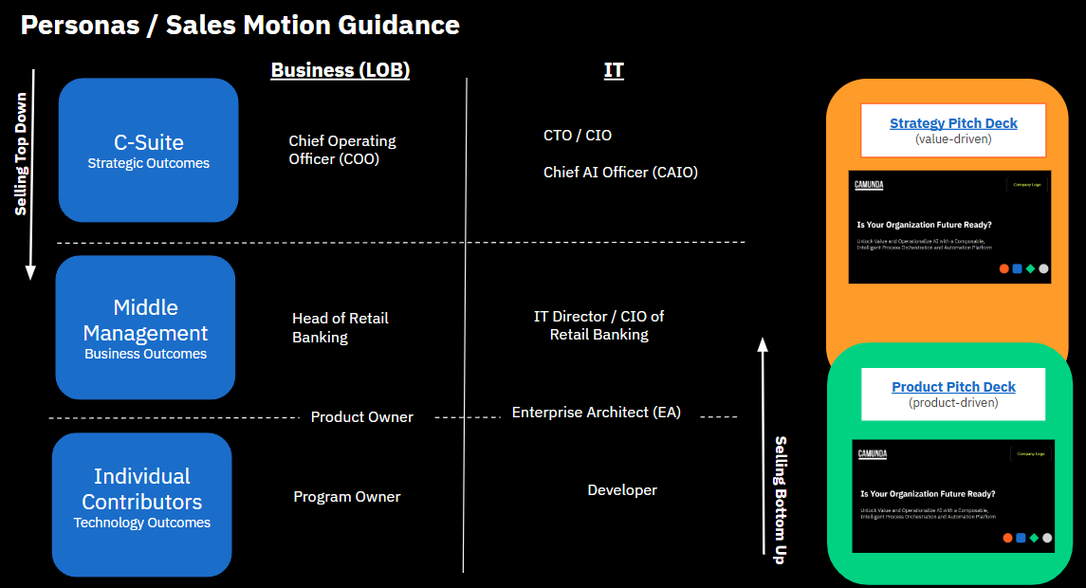
2025 Messaging | Internal Guidance
Summarized Pitch (“Elevator Pitch”)
AI is disrupting businesses and business models
CIO/CTO are investing in AI but face challenges - fragmented AI, tech debt, and complexity (compounding)
Companies are unable to unlock value
Camunda can help - work with your existing tech and unlock value.
Our unique value proposition is a composable, open, collaborative, scalable and intelligent PO&A.
Camunda helps you realize value today and be ready for tomorrow – future-proof process architecture
1
2
Notes:
View Jakob pitching our strategic narrative at CLocal HERE
Archived slides

Slide 7
Building the AI-Native Enterprise
Company Logo
Bring standardization and flexibility together to power the next era of total experience
Date
Notes:
The pain of CIOs pressured to Add AI everywhere and drowning in 30+ PoCs across different domains, LOBs

Slide 8

Technology is evolving faster than ever
84%
of executives believe they won’t achieve their growth objectives unless they scale AI
Source: AI: Built to scale, Accenture, 2024
Notes:
The speed of technology change isn’t something I’ve experienced in decades
Nearly every week we see a new model, framework or Agentic tool released.
84% of leaders don’t think they’ll achieve growth goals without scaling AI
The boardroom pressure is there. Every meeting they want to know “What you’re doing with AI”
Majority of executives are trying to embrace AI and build an agent-infused workforce
While AI isn’t new, this new variety is forcing everyone to completely rethink how they’ve built and automated processes

Slide 9
Moving towards autonomous actions
Rules Based
Dynamic
Deterministic Process Flows
Dynamic Process Flows
RPA
iPaaS
BPM
Decisioning
Low Code
Case Management
Notes:
[GUIDANCE]
Use this slide if the conversation needs to reinforce PO&A foundation before transitioning to latest tech development with Agentic AI
[Talk Track]
Historically BPMN was used to achieve a high degree of automation and consistent operations.
This is where traditional automation shines when things need to happen in a very predictable and repeatable way.
Now AI has opened up a new world of possibilities for handling dynamic process flows.

Slide 10
Moving towards autonomous actions
INCREASING HUMAN OVERSIGHT
GREATER AUTONOMY
Early Artificial Intelligence
Generative AI
Agentic Systems
Machine Learning
Chatbots
Deep Learning
Personal Productivity
Autonomous Operations
Computer Vision
Neural Networks
Natural Language
Scaled Value:
complexity & risk
Localized Value
Notes:
Each advance in AI was revolutionary at the time, boosting accuracy and efficiency.
But humans were still needed for many complex tasks where things weren’t clear or a process needed to follow an unbreakable set of rules.
Agentic AI is changing all that. Now Agents can interact dynamically and handle complex cases.
But with this brings added complexity and risk. Left without control, can introduce unneeded risk and complexity.
With how fast everything is changing, it’s not surprising there’s lots of confusion in the space in what is the difference between AI agents, chatbots, and agentic AI
Let’s set a baseline definition so we all understand. [CLICK]

Slide 11
What are AI Agents?
AI Agent
“Systems of foundation models, rules, architectures, and tools which enable software to flexibly plan and adapt to resolve goals by taking action in their environment, with increasing levels of autonomy.”
Memory
Observation
Tools
Agent Brain
Actions
Environment
Goals
Source: Agentic AI Is Rising And Will Reforge Businesses That Embrace It, Forrester, 2025
Notes:
There are many definitions but the market has formed a definition around core criteria
The key here is taking action with increasing levels of autonomy. While AI agents can help with simple repetitive tasks (much like RPA did), Agentic AI now makes it possible to create a digital workforce.
They can work together, agents with agents – and humans – together in an E2E process. Achieving this level of sophistication needs a careful blend of classical, deterministic process flows, along with new, dynamic abilities. To accomplish this, you need [CLICK]

Slide 12
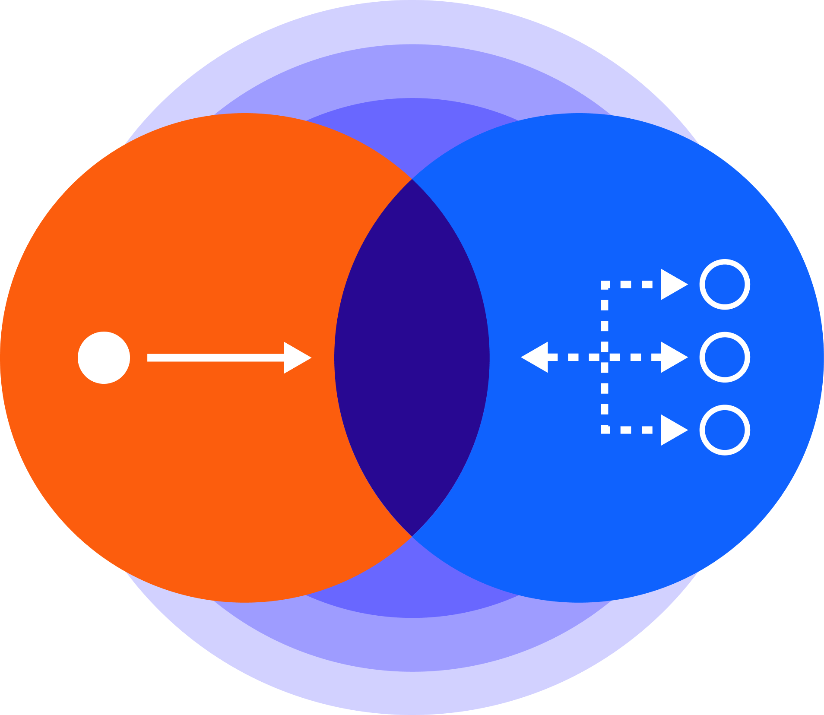
Agentic Orchestration
Coordinating intelligent agents, systems, and people
Deterministic Orchestration
Dynamic
Orchestration
Notes:
Agentic Orchestration Transition to Explanation

Slide 13
Agentic orchestration powers the AI-native organization
Blends deterministic and dynamic (AI-driven) business processes
Unites the best of humans and machines
Adds visibility, auditability, and guardrails
Handles long-running, complex, and high-performance processes
Provides flexible foundation to adapt to changing technology and business needs
Deterministic
Dynamic
Notes:
1 min
[summarize slide bullets]
At flexible foundation bullet; reinforce:
Technology is changing fast. The LLMs we’re using today are the worst we’ll ever experience.
That’s how quick things change and organizations need to be able to adapt. Processes you’ve tried to automate with minimal human oversight is now possible leading to better CX, lower costs to serve, and happier employees.
Without compromising on policies, regulatory adherence.

Slide 14
Challenges for adopting next-era AI
40%
of agentic AI projects will be scrapped by 2027 - Gartner
77%
of leaders are concerned about GenAI risks - Deloitte
44%
have already seen AI output go wrong - McKinsey & Co
are scaling AI at an enterprise level, embedding the technology into core business strategy.
- Accenture
Only 8%
of CEOs report that rapid investment has resulted in disconnected technology - IBM
50%
Notes:
Even with all the excitement around Agentic - PoCs are failing, and many orgs are learning that real-world agentic isn’t easy. (Gartner Stat) Failure isn’t because the tech doesn’t work. It fails because it can be expensive, complicated, difficult to maintain, and often solving the wrong problem. Legacy systems, fragmentation and incomplete data—all pose existential risks to agentic systems tasked with making autonomous decisions.
The complexity of critical, real-world business processes makes it difficult to implement agentic.
According to a recent study, 50% of CEOs report that rapid investment has resulted in disconnected technology; GenAI being the #1 contributor to Tech Debt.
Yet every board is asking “What are we doing with GenAI”.
But you can’t just bolt on AI to a brittle tech stack or a broken process. [CLICK]
DIQs
Costs
Which model for task?
Is AI cheaper than Human?
Accuracy
How correct is output?
Does it follow policy?
Risk
Is AI lowering cSAT?
Did we break a regulation?
Fragmentation
How can Agentic and legacy fit together?
What if my data is siloed results in low quality?
Sources:
Gartner: 40% of agentic AI projects scrapped by 2027: https://www.reuters.com/business/over-40-agentic-ai-projects-will-be-scrapped-by-2027-gartner-says-2025-06-25/
McKinsey: 44% of orgs have already seen AI output go wrong - https://www.mckinsey.com/capabilities/quantumblack/our-insights/the-state-of-ai-2024
Deloitte: 51% of execs say GenAI raises regulatory exposure 77% saying they were concerned “to a large extent” about GenAI risks may impact their cybersecurity strategies. Only 23% say they’re prepared to handle risk and regulation
Accenture: 95% of IT leaders say integration is a top AI blocker
Over 40% of agentic AI projects will be scrapped by 2027, Gartner says - reuters.com https://www.gartner.com/en/newsroom/press-releases/2025-06-25-gartner-predicts-over-40-percent-of-agentic-ai-projects-will-be-canceled-by-end-of-2027
More than 40% of agentic artificial intelligence projects will be canceled by the end of 2027 due to escalating costs and unclear business value, according to a report by Gartner.

Slide 15
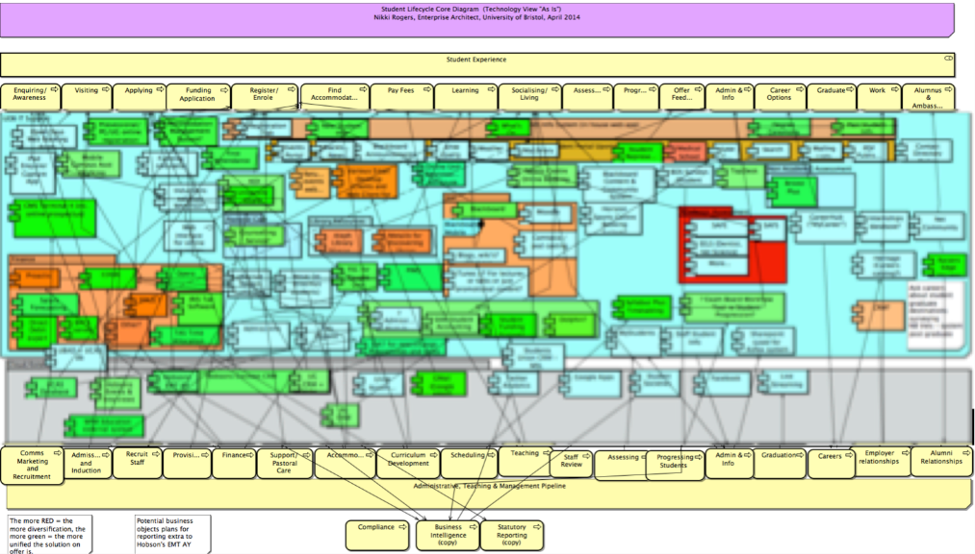
“Just add AI” multiplies fragmentation
Notes:
Cannot just throw in AI - “Spaghetti Architecture”
Historically grown Complexity; GenAI is accelerating this
Just throwing in AI will make it worse - exponentially multiply the underlying issues
Supporting Extra Data
Study from Accenture showed that “companies with a focused AI strategy are nearly 3 times more likely to exceed their ROI expectations from AI investments.”

Slide 16

Fragmentation multiplies inefficiencies
Customer journey
RPA
CRM
IDP
ERP
AI
Value
Reduced time to market, ROI, and visibility.
Fragmented approach compounds tech debt and limits innovation and tech value
Business Strategy
Technical Execution
alignment
Notes:
Because introducing new tech to a fragile architecture will slow your pace of innovation.
Point solutions mean isolated automation and shadow IT
Either in business or in IT => misalignment
Adding to complexity, technical debt – which will only grow
Costly to maintain; even harder to adapt and evolve –
=> you’re stuck in a value trap
Happened with RPA etc.
Throw in AI will make it even worse!

Slide 17
Buy, build, and blend what works for you
Customer journey
Process orchestration
RPA
CRM
IDP
ERP
AI
Value
1
2
3
Visibility
Flexibility
Scalability
Business Strategy
Technical Execution
Notes:
What’s needed is an end-to-end orchestration layer
Taming complexity of scattered point solutions, legacy systems, and whatever emerging tech comes next
Orchestrating apps, services, AI incl agents
Along e2e customer journey, employee journey etc
This let’s you take advantage of the right tools for the job, in order to deliver consistent experiences with the flexibility to adapt as business needs or technology change

Slide 18




























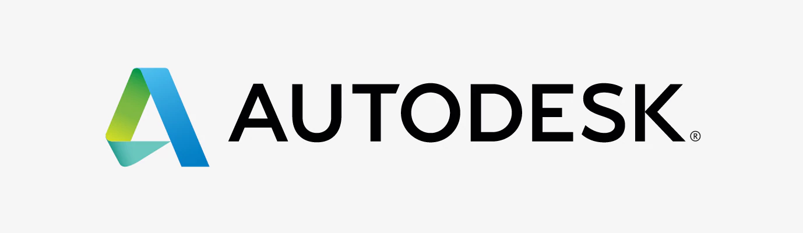


































From idea to production with total control
“Speed to market skyrocketed. What took engineers 4–5 days, product owners now do in 1–2 hours with Camunda.”
“We increased the automation rate by more than 65% and reduced average claim process time by over one-third.”
“We injected AI into our money transfers process, resulting in 6x faster payment transfers, and 50% fewer errors.”
Notes:
Over 600 enterprise customers orchestrate mission-critical core business processes with Camunda.
Our sweet spot is mission-critical core business processes. These are the 10% of your processes that are generating 90% of the value – whether customer facing, internal risk and decisioning, or backoffice processes that must run as designed eerie time,.
Driving meaningful business outcomes, for example:
Top 10 US bank sped up TTM for risk rules changes by 24x
VA processes 2m claims per year to care for +6.5m veterans and their families – the largest integrated healthcare org in US
A major bank freed employee capacity and reinvented its payment process for over 16m customers

Slide 19


Key benefits of agentic orchestration
Full Transparency
Dynamic Oversight
Orchestrated Control
One visual model aligns strategy and execution while speeding up time to value
Precisely control and see every action for consistent experiences and compliance
Ensure consistent experiences and maintain compliance with policies
Performance at Scale
Context That Persists
Dynamic Oversight
Handle millions of concurrent interactions without slowing down or bottlenecks
Keeps memory over any length of time; from milliseconds to years
Precisely control when to involve humans in a process
Notes:
To take advantage of Agentic AI you need four key capabilities
Full Transparency One executable model visually shows every step, tool, and hand-off, so strategy and execution stay united. BPMN and DMN simplify maintenance and migration by decoupling technology and business logic. You can swap tools, LLMs, decisions, and subprocess quicly, slashing total cost of ownership and time-to-market without interrupting rhythm of business.
Dynamic Oversight Guardrails can be designed in multiple ways to maintain consistency and compliance even with a dynamic flow. People jump in only for judgment calls; agents move the grunt work, lowering cost-to-serve and lifting both CX and employee EX.
Performance at Scale Picture an agentic system. One customer facing processes triggers 5 agents. Each of those spins up two ages – each using five systems. That's 50 tools firing in real time. Multiply this by 100,000 customers and you can see the growing need for low latency and high throughput.
Context That Persists State never disappears. The engine can pause for a millisecond or a month and pick up exactly where it left off. This way your agents can run continuously and never break context until the goal is achieved. Perfect for long journeys like onboarding, claims, or other case management. Let’s look at this a little closer

Slide 20
Executable BPMN. Event driven. Transparent.
Controlled flexibility with modeled agent handoffs
Dynamic flows
AI Agent
Multi-agent orchestration
Coordinate multiple agents with runtime routing logic
Deterministic flows
Consistent experience and policy adherence
+
Agents orchestrates subprocesses
Trigger subprocesses autonomously
Event-driven
responses
Waits, listens, and reacts no matter how long it takes
Bring humans in the loop when necessary
Escalation to humans
Notes:
Here’s a simplified version of what I just mentioned:
One executable model blends fixed and dynamic flows. The orange blocks lock down must-run steps—KYC, payments.
When an AI agent takes over, the flow turns dynamic, yet it’s still the same BPMN model.
Zeebe is event-driven with long memory. It waits a millisecond or years for the next event, LLM callback, or cron job in a legacy system.
Agents wait, resume, and never lose context before completing their work and accomplishing their goal.
Humans plug in where it makes sense or is required by regulation or policy.
Escalations route to an approver; business logic spins up subprocesses or can call new agents like “tools” on the fly.
Every action and decision – human or machine – is recorded.
Ops can trace any instance in real time, auditors get immutable logs.

Slide 21
Agentic applications across industries
Financial Crime & Compliance
Banking & Financial Services
Intent-Based Autonomous Networks Telecommunications
Demand Forecasting & Optimization
Supply Chain & Logistics
Health Insurance Appeals Management
Insurance
Notes:
Here are a few examples across industries are bringing value – to customers, employees, and the business overall.
The pattern is the same across sectors. High-friction busywork steals time, tie up cash, and hurts experience.
Capital markets
Autonomous trade-exception handling cut delays 98 % and freed seven-times analyst capacity.
Telecom
AI Agents spot network degradation in real time, launch a fix before customers notice.
Supply chain
24/7 agent systems reroute inventory when low or no-stock potentially impacts a major order– ensuring the business they’re serving isn’t disrupted.
Health-insurance
Appeals are auto-triaged with policy-safe recommendations to coordinators.
In every case Camunda provides the orchestration layer—event-driven, human-in-loop, fully auditable—so AI can move from pilot to production.
But successful implementation has a few common traits in their architecture that makes them successful.
PROCESS BACKGROUND INFORMATION:
BFS
Financial Crime & Compliance
Shifts KYC / CDD from static to dynamic – perpetual KYC monitors and assesses risk level for customers continuously. Combines massive 3rd party and proprietary datasets (structure and unstructured) to screen for sanctions, adverse media, politically exposed people. Dynamic risk thresholds reduce # of customer requiring “enhanced due diligence” so low-risk customers onboard faster.
Telco
Autonomous Networks
Network optimization process requiring cross-domain integration for Communication Service Providers. Proactively monitors network degradation. Creates and deploys remediation plans to ensure consistent operations. Combines “digital twins” traditional ML/AI, utility data (IoT) in a multilayer approach.
Supply Chain / Logistics
Demand Forecasting and Optimization
24/7/365 Agentic workforce monitoring and analyzing sales trends and forecasts to optimize materials, goods, and routes ensuring disruptions are minimized. Can even include suggesting “like for like” replacements if a good is out of stock.
Insurance
Health Insurance Appeals Management
Managesthe intake and review of appeals for denied medical claims (important and stressful time). Combines unstructured appeal documents, retrieves corresponding claims data, and generates tailored suggestions for Appeal Coordinators to action in accordance with organizational-approved guidelines (HITL)

Slide 22
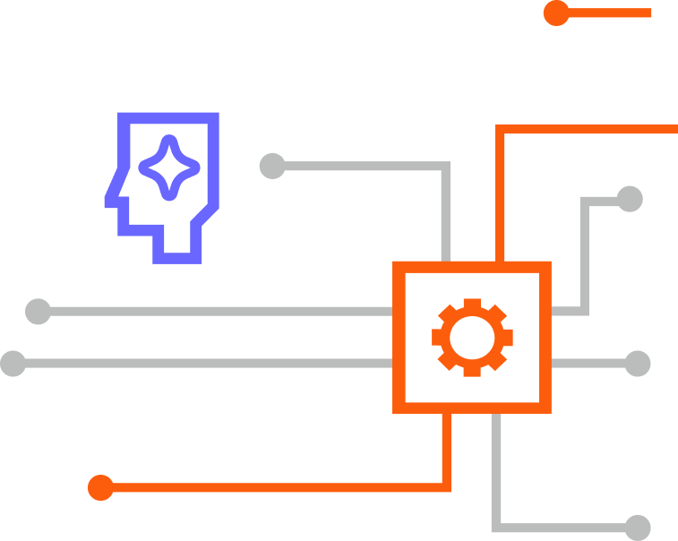
Let’s design your
AI-native enterprise
Assess Capabilities
Align your strategic goals and technical capabilities during a more technical discussion.
Accelerated Pilot
Our teams work together to identify and build one high-impact agentic process to prove concept.
Partner Collaboration
Your trusted partner. Our expertise. Increase the output and potential for your agentic projects.

Slide 23

Thank you
camunda.com
linkedin.com/company/camunda
@CamundaTeam
Notes:
Alright everyone, that’s all the time we have for today. Let’s keep the conversation going.

Slide 24
SUPPLEMENTARY SLIDES

Slide 25





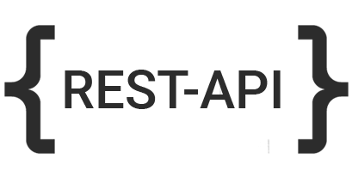


Simply works with everything
YOUR
Front End
Multimodal, Omnichannel, Mobile
Digital Twin, Personalized, Proactive, Predictive, Relevant
Agentic Orchestration (end-to-end)
YOUR
Technology
and Tools
Task Automation
Decisions
RPA Bots
IDP
Agents
Human in the Loop
AI computer use
…
Integration (APIs, Events, Documents, Data)
YOUR
Core Systems
Legacy Applications
Systems of Record
Real-time Data
Data Warehouse
APIs & Microservices

Slide 26

Camunda powers the AI-led enterprise
A vendor-neutral platform designed to handle real-world complexity and scale
AI Agents
Marketplace
Human Tasks
APIs
IDP
Microservices
Decision Intelligence
RPA
Open
Composable
Collaborative
Scalable
Intelligent
Notes:
Camunda’s mission since 2013
A process orchestration & automation platform
End-to-end process orchestration powered by BPMN
At the core
Complemented with “read icons”
Including AI Agents

Slide 27






Agentic orchestration solutions built by Camunda partners
Agentic AI Call Quality Audits
Agentic Trade Exception Management
Review every customer call, reduce audit times by 94%, and provide performance coaching in real time.
Speed up resolutions 45% by orchestrating the full trade lifecycle utilizing automation and agentic AI.
Agentic Transaction Monitoring
Agentic Auto Insurance Claims
Reduce false positives, and speed up FCC investigations using AI that learns and improves over time.
Provide 24-7-365 support with a dynamic digital workforce to speed up claims and keep customers informed.
Compliance Monitoring Agent
AI Customer Service Agent
Catch policy violations in real time, enforce rules, and provide full audit trails with multi-channel insights.
Deliver better customer experiences without adding headcount while resolving inquiries in 58% less time.
Explore more solution accelerators in Camunda Marketplace.
Notes:
Customers embracing to drive enterprise-grade AI adoption
All sorts of use cases, from customer services, to complex BFSI solutions like transaction monitoring for financial crime or citizen services in public sector
Some examples created by our partners

Slide 28
Camunda | AI / Agentic Orchestration
Go to Product Pitch Deck (double click on roadmap, features, capabilities)

Slide 29



at a glance.
$100m
Annual Recurring Revenue
(Continued Growth)
500
Camundi
$100M
(Q3 2024)
160+
Partners
600+
Enterprise Customers
$50M
(2022)
100k+
Orchestrators
$10M
(2018)
$1M
(2012)
<$1M
(FY08)
Notes:
We’ve come a long way
Since we disrupted the “BPM” market
Clearly outperformed market growth
Why: Solved relevant customer problems
With Clear vision and relentless execution
Also our path going forward
Next chapter for Camunda and Automation market
Let me fill you in

Slide 30





Camunda | Helping Customers Transform
Camunda empowers over 600 customers globally and over 5,000 use cases
Financial Services
Insurance
Telecom
Logistics
Software
Manufacturing
Public Sector
Other Industries
Notes:
Today, we have over 500 customers across the globe and across industries using and transforming with Camunda
Our process orchestration technology is very flexible, which means our customers using our software for many different types of use cases
Many marquee brands and household names - this is just a small sample

Slide 31
2025 | ChangeLog
Internal only page
June | July Changes | August Changes | September
Narrative – Agentic Orchestration Focus

Slide 32
Better Together
Product Deck
+
Your Logo Here
Where great technology and skilled expertise meet

Slide 33
Partnership Summary
Add your partner Tier Logo here
Camunda Partner since <X Date>
Partner Type <Services, Sales, Solution>
Partner Tier <Silver/Gold/Platinum>
Trained resources located in <GEOs, Industries>
<Certified Resources>
# client deployments
<Scope of Partnership>
<Geographies, industries and clients served>
<Services offered by the partner>
Notes:
Why Partner with Camunda? This speaks to the the strategic importance as to why the partner is investing in Camunda.
What customer value do we drive with Camunda? ROI outcomes
Why is Camunda a superior technology ?

Slide 34
Better Together
Add your partner Tier Logo here
Enterprise-grade Agentic Orchestration
Partner tagline
Camunda enables organizations to orchestrate and automate processes across people, systems, and devices to continuously overcome complexity, increase efficiency, and fully operationalize AI. Built for business and IT, Camunda’s leading orchestration and automation platform executes any process at the required speed and scale to remain competitive without compromising security, governance, or innovation. Over 700 companies across all industries, including Atlassian, ING, and Vodafone, trust Camunda with the design, orchestration, automation, and improvement of their business-critical processes to accelerate digital transformation.
Partner Company description
Notes:
The latest version of the Camunda company description can be found at https://camunda.com/brand/
Correct as of September 9, 2025
English version
About Camunda
Camunda enables organizations to orchestrate and automate processes across people, systems, and devices to continuously overcome complexity, increase efficiency, and fully operationalize AI. Built for business and IT, Camunda’s leading orchestration and automation platform executes any process at the required speed and scale to remain competitive without compromising security, governance, or innovation. Over 700 companies across all industries, including Atlassian, ING, and Vodafone, trust Camunda with the design, orchestration, automation, and improvement of their business-critical processes to accelerate digital transformation. To learn more, visit camunda.com.
German version
Über Camunda
Camunda ermöglicht es Unternehmen, ihre Prozesse über Menschen, Systeme und Geräte hinweg zu orchestrieren und zu automatisieren. So lassen sich Komplexität bewältigen, Effizienz steigern und auch KI vollständig operationalisieren. Camundas führende Orchestrierungs- und Automatisierungsplattform wurde gleichermaßen für Fach- und IT-Abteilungen entwickelt. Sie führt jeden Prozess mit der nötigen Geschwindigkeit und Skalierbarkeit aus, um wettbewerbsfähig zu bleiben – und das ohne Kompromisse bei Sicherheit, Governance oder Innovation. Über 700 Unternehmen aller Branchen, darunter Atlassian, ING und Vodafone, vertrauen zur Orchestrierung, Automatisierung und Optimierung ihrer geschäftskritischen Prozesse auf Camunda, um ihre digitale Transformation zu beschleunigen. Weitere Informationen finden Sie unter camunda.de.
French version
À propos de Camunda
Camunda permet aux entreprises d’orchestrer et d’automatiser les processus impliquant personnes, systèmes et appareils afin de maîtriser durablement la complexité opérationnelle, accroître l’efficacité et exploiter tout le potentiel de l’IA. Conçue pour les équipes métier et les services informatiques, la plateforme d’orchestration et d’automatisation de Camunda permet d’exécuter tous types de processus, avec la rapidité et l’échelle requises pour améliorer la compétitivité, tout en garantissant sécurité, gouvernance et innovation. Plus de 700 entreprises leaders de leurs secteurs, telles que Atlassian, Decathlon, EDF et Vodafone, font confiance à Camunda pour concevoir, orchestrer, automatiser et optimiser leurs processus critiques, accélérant ainsi leur transformation digitale. Pour en savoir plus, consultez camunda.com.

Slide 35
Enabling Customer Success (Optional)
Optional slide to include 1 or more joint customer success story examples, whether they are named or anonymous reference examples
Perhaps using a different format if you have creative idea here for layout
Client <name or anonymous description>
Company Size
Solution Need
Solution Deployed
What the partner did to implement the solution (40 words or less)
Any outcome(s)

Slide 36
Joint Client Success
Customer Summary:
Client:
Company Size:
Solution Needs:
Solution Deployed:
Solution Description:
Name
Size
Needs
Solution(s)
What the partner did to implement the solution (40 words or less)
The Outcome
Business outcome
Business outcome
Business outcome
*not an external reference
36

Slide 37
2025 | Overview | Internal Guidance
Summarized Pitch (“Elevator Pitch”)
AI is disrupting businesses and business models
CIO/CTO are investing in AI but face challenges - fragmented AI, tech debt, and complexity (compounding)
Companies are unable to unlock value
Camunda can help - work with your existing tech and unlock value.
Our unique value proposition is a composable, open, collaborative, scalable and intelligent PO&A.
Camunda helps you realize value today and be ready for tomorrow – future-proof process architecture
1
2

Slide 38
Is Your Organization Future Ready?
Company Logo
Unlock Value and Operationalize AI with a Composable, Intelligent Process Orchestration and Automation Platform

Slide 39
The Process Orchestration and Automation Platform Camunda’s differentiation is anchored in five principles
Composable
Intelligent
Open
Scalable
Collaborative
Notes:
https://camunda.com/blog/2025/02/what-sets-camunda-apart/
Camunda offers a composable, cloud-native platform with embedded intelligence and open standards, enabling seamless collaboration between business and IT through the shared languages of BPMN and DMN and a common process model. Its process orchestration and automation capabilities deliver the scale and resilience needed to manage complex processes, adapt to changing business needs, and unlock value across the enterprise.
Camunda is a composable, cloud-native process orchestration and automation platform with embedded intelligence
Camunda is:
Composable: it has an integrated yet flexible architecture that facilitates the use of best-of-breed technology and reuse of what you build
Open: it integrates with a variety of applications, systems, and services so you can scale your automation architecture
Collaborative: it enables you to align IT and the business using a shared process model and language
Scalable: it ensures your most complex, business-critical processes run reliably, every time
Intelligent: it helps you prepare for the autonomous enterprise by blending deterministic and non-deterministic process execution (note: this is known as agentic process orchestration)
Note: The product pitch deck contains one slide per differentiator with more detail.
Side notes:
Foundation is a PO Platform, but expanding to all aspects of automation
Incl. Human in the loop, decision automation, integration (microservices and low-code connectors), now also covering RPA, IDP, and more to come.
Constant Key concepts / differentiators:
Composability, embedded intelligence
Open standards (BPMN, DMN)
Support Biz-IT collaboration with one language, one model
Execution is horizontally scalable, cloud-native, and highly resilient
Battle proven for mission critical core processes

Slide 40
Composable
Integrated yet flexible architecture facilitates best-of-breed technology and reuse
Best of breed without compromise
“Camunda's agile, microservices-based architecture has provided us with the flexibility to rapidly adapt and configure workflows, empowering us to meet customer demands with minimal reliance on engineering.”
– Nicki Todd, SVP of Technology at First American
Combine Camunda task automation with other tools and custom code for maximum flexibility
Orchestrate any tool or service
A connector marketplace and robust SDK make integration easy as well as fully customizable
Flexible implementation options
Choose SaaS or Self-Managed and use your preferred cloud, Kubernetes, identity provider
Notes:
Camunda is a composable process orchestration and automation platform, meaning it has an integrated, yet flexible, architecture that enables you to choose best-of-breed technologies and reuse the components of your process automation setup
Features:
Best of breed without compromise:
Combine Camunda task automation (such as RPA and IDP) with task automation that’s executed by other tools
Insert custom code into processes for highly specialized use cases
Orchestrate any tool or service:
Our connector marketplace offers pre-built connectors for many different tools and technologies
The connector SDK allows you to customize pre-built connectors or even build your own
Flexible implementation options:
Choose Camunda SaaS or Camunda Self-Managed
For SaaS, choose GCP or AWS
For Self-Managed, use your preferred cloud provider or on-premises setup
Use your preferred flavor of Kubernetes (such as Amazon EKS)
Use your own identity provider for authenticating users and single sign-on
More information:
https://camunda.com/blog/2024/06/how-first-american-leverages-camunda/
https://camunda.com/blog/2024/07/why-composable-process-automation/
https://camunda.com/blog/2025/01/composability-for-best-in-class-process-orchestration/
https://camunda.com/blog/2023/06/architecture-connectors/

Slide 41
Open
Integrate with a variety of applications, systems, and services to scale your architecture
Fits into your tech stack
“To further automate our business processes, we are using Camunda. The open platform permits the implementation of our individual needs in a way that closed business process management suites just cannot achieve.”
– Marko Lehn, Team Lead Software Engineering at Zalando
Works with your preferred source control, CI/CD pipelines, and programming languages
Open standards accelerate teams
BPMN and DMN standards facilitate collaboration and alignment between IT and the business
Developer-friendly design
Well-documented APIs and SDKs, plus polyglot clients, enable easy integration and customization
Notes:
Camunda has an open architecture, which means you can integrate it with a variety of applications, systems, and services in order to scale your process automation architecture
Features:
Fits into your tech stack:
Camunda works with your preferred source control tool (such as GitHub or GitLab)
Camunda fits into your CI/CD pipeline so you can automatically test and deploy processes just like any other software you build
You can use your preferred programming languages to insert custom code into processes and run Zeebe clients
Open standards accelerate teams:
Camunda uses BPMN for process modeling and DMN for decision modeling
These are open ISO standards that facilitate collaboration and alignment between IT teams and business stakeholders
Developer-friendly design:
Software developers love our well-documented APIs and SDKs
We support Zeebe clients in multiple programming languages so developers can start working with Camunda quickly
More information:
https://camunda.com/case-study/zalando/
https://camunda.com/zeebe/advanced-workflow-engine/

Slide 42
Collaborative
Align IT and the business using a shared process model and language
Next-level collaboration
“I think of a mortgage process as a constellation of several sub-processes, each of which should be orchestrated by its own right… Using BPMN to model the business process as-is allowed us to bridge the gap between the business and the ‘techies.’”
– Alexander Lorenzen, Domain Architect at BEC Financial Technologies
IT and business stakeholders build and test processes in a shared modeling environment
Build with reusability in mind
Reusable processes, decision tables, forms, and connectors make onboarding new teams easy
Data-driven improvements
Integrated intelligence provides complete visibility on process health and performance
Notes:
Camunda helps IT teams and business stakeholders align because they work together on a shared process model, using the shared modeling languages of BPMN and DMN
Features:
Next-level collaboration:
IT users and business users build and test processes in a shared modeling environment, Camunda Web Modeler
What you see in Modeler is exactly what Camunda’s workflow engine, Zeebe, will execute
Build with reusability in mind:
Process models, decision tables, forms, and connectors are all reusable, which makes it easy to onboard new teams and projects to the platform
Data-driven improvements:
Camunda Optimize has integrated intelligence that provides complete visibility on process health and performance, so you can identify the process changes that will have the highest ROI
More information:
https://camunda.com/case-study/transforming-financial-services-solutions-with-bec/

Slide 43
Scalable
Ensure your most complex, business-critical processes run reliably, every time
Unlimited horizontal scalability
“We want to reach the point where Camunda handles all our volumes. We expect this to be in the tens of millions of process instances, every single day. Camunda 8 is cloud-native, so we can add instances easily and always maintain enough headroom to handle an unexpected peak.”
– Larisa Kvetnoy, Director of Operations Technology and Strategy at Barclays
Event streaming avoids database bottlenecks and can scale process throughput infinitely
Enterprise-grade resilience
A distributed architecture ensures continuity in the case of hardware or network failure
High availability worldwide
A failover architecture supports replication across global data centers for high availability
Notes:
Camunda is a highly scalable process orchestration and automation platform, which means it helps ensure your most complex, business-critical processes run reliably, every time
Features:
Unlimited horizontal scalability:
Camunda’s workflow engine, Zeebe, uses event streaming to avoid database bottlenecks and scale process throughput infinitely
Enterprise-grade resilience:
Zeebe has a distributed architecture, which ensures business continuity in the case of a hardware failure or network outage
High availability worldwide:
Zeebe’s distributed architecture support failover through replication across global data centers, providing high availability
More information:
https://camunda.com/case-study/barclays/
https://camunda.com/blog/2024/08/scaling-workflow-engines-intuit-camunda-8-zeebe/
https://camunda.com/zeebe/advanced-workflow-engine/

Slide 44
Intelligent
Prepare for the autonomous enterprise by blending deterministic and non-deterministic execution
Innovate with visibility and control
“We're making great progress on blending deterministic with dynamic execution, so that our customers get the ability to handle mission-critical end-to-end processes with the creative power of AI, combined with the reliability and efficiency of deterministic workflow execution.”
– Jakob Freund, CEO and Co-founder of Camunda
Apply AI/ML where it makes sense without sacrificing reliability or regulatory compliance
Eliminate AI silos
Avoid creating AI tech debt by integrating AI/ML into existing end-to-end business processes
Improve team productivity
Assistive AI features such as copilots put process designers on the fast track to value delivery
Notes:
Camunda helps you prepare for the autonomous enterprise, powered by AI, by enabling you to blend deterministic and dynamic (agent-powered) process execution
Features:
Innovation with visibility and control:
Apply AI/ML tools and services where it makes sense without sacrificing process reliability or regulatory compliance
Eliminate AI silos:
Avoid creating technical debt by integrating AI/ML tools and services into end-to-end business processes along with other tools, technologies, and people
Improve team productivity:
Camunda Copilot puts process designers on the fast track to value delivery through capabilities such as BPMN model creation, form creation, and more
More information:
https://camunda.com/resources/leverage-ai-powered-automation/
https://camunda.com/platform/ai-enabled-process-orchestration/
https://camunda.com/agentic-orchestration/

Slide 45
Camunda | Operationalize AI with Camunda
Process Orchestration & Automation Platform
AI enabled
Design & Implement
Test & Deploy
Automate
Improve
Developers and business users collaborate to design processes, decisions, and forms.
Developers and testers ensure the end-to-end process is working as intended.
Enterprise-grade automation. Built for today’s business complexity, loved by developers.
Teams have the insights needed to fix the highest ROI problems for business processes.
Modeler Design BPMN process models and DMN decision tables, assisted by AI Copilots.
Rapid Process Testing Simulate processes without affecting production systems and deploy with confidence.
Zeebe Workflow & Decision Engine Cloud-native event streaming for unparalleled scale and resilience.
Optimize Monitor KPIs and analyze performance with one model for visualization.
Integrated AI Agents Model, deploy & manage AI agents alongside process models.
Workers AI agents, connectors, RPA, document handling, IDP, and custom workers.
CI/CD Integration
Forms Drag & drop UI builder to capture data and guide user interactions across your processes.
Accelerate time-to-market by integrating with your SDLC/DevOps ecosystem.
Operate
IDP Ingest, digitize, and process documents with AI to increase productivity and improve experiences.
Manage and troubleshoot processes with one model for management.
RPA Integrated RPA helps bridge the gap between legacy and AI for applications lacking API connectivity.
Tasklist
Web app for tasks that must be handled by knowledge workers.
Connectors & Marketplace Integrate and operationalize connectivity across all systems and LLMs.
Manage
Console
Identity
Enterprise SSO
Extend
End-to-end governance of your Camunda installation.
Manage clusters and API keys, review audit logs, and perform one-click upgrades.
Manage applications, APIs, users, and roles.
Enterprise single sign-on for consistent authentication and secure user access across your entire organization.
Complete library of SDKs and APIs to integrate and extend process applications.
Notes:
Camunda’s process orchestration and automation platform supports the entire lifecycle of process improvement
Camunda has intelligently integrated and enabled AI into its platform - helping organizations to operationalize AI across their enterprise
Camunda’s AI-enabled platform means users can design, deploy, automate, optimize, and govern their processes with greater intelligence, adaptability, and control.
More details
Design & Implement: developers and business users collaborate to design processes, decisions, and forms - assisted by with AI Copilots.
Test & Deploy: Developers and testers ensure the end-to-end process is working as intended
Automate: Enterprise-grade automation, built for today’s business complexity, loved by developers. Automate your processes with AI agents, connectors, RPA, document handling, IDP, and custom workers.
Improve: With Optimize, leadership and teams can monitor KPIs and analyze performance with one model for visualization. This gives you critical visibility and oversight across all your processes and around AI Agents.
Managed: Full governance over your installation and usage

Slide 46
Camunda | Operationalize AI with Camunda
Operationalize AI so you can drive business outcomes today and be ready for whatever comes next
Intelligent process
Camunda Copilot
Autonomous AI
Orchestrate AI tools and services
Fast track to orchestrated processes
Intelligent execution and optimization
Introduce generative and predictive AI into existing processes with low risk
Share reusable AI connectors to govern adoption using centrally managed AI services
Enable IT and business users to rapidly prototype process assets with AI-powered assistance
Designed to enhance BPMN and DMN as a common language for collaboration
Uncover hidden value in your most critical end-to- end business processes
Blend deterministic and non-deterministic process execution with AI agents
Notes:
Camunda’s AI capabilities fall into three categories:
Intelligent process is about orchestrating different types of AI tools and services. With Camunda, you can orchestrate AI and eliminate AI silos by integrating products such as OpenAI and Hugging Face into end-to-end business processes.
Camunda Copilot is an assistive AI feature that boosts productivity for both IT and business users. Copilot has a variety of features such as our BPMN copilot, form copilot, and more.
Autonomous AI is about using AI agents to enhance processes and process execution data to improve them over time.

Slide 47
Camunda | Operationalize AI with Camunda
Operationalize AI so you can drive business outcomes today and be ready for whatever comes next
Intelligent process
Camunda Copilot
Autonomous AI
Orchestrate AI tools and services
Fast track to orchestrated processes
Intelligent execution and optimization
Out-of-the-box connectors for popular AI products
Blueprints for AI-driven business processes
BPMN
FEEL
Connectors
Forms
Play Mode
Documentation
Agentic AI support through a Next Best Action framework and BPMN ad-hoc sub-process
ML-ready process execution and performance datasets
Notes:
More information:
Intelligent process features
Out-of-the-box connectors: https://marketplace.camunda.com/en-US/listing?pl=3038&scat=63914&locale=en-US
Blueprints for AI-driven processes: https://marketplace.camunda.com/en-US/listing?pl=3082&cat=107793&page=1&locale=en-US
Camunda copilot capabilities
BPMN: https://docs.camunda.io/docs/8.7/components/early-access/alpha/bpmn-copilot/
FEEL: https://docs.camunda.io/docs/next/components/early-access/alpha/feel-copilot/
Connectors: https://docs.camunda.io/docs/8.7/components/modeler/web-modeler/advanced-modeling/refactoring-suggestions/
Forms: https://camunda.com/blog/2023/06/build-forms-faster-camunda-form-builder-generative-ai/
Play Mode: Coming soon
Documentation: https://docs.camunda.io/docs/8.7/components/modeler/web-modeler/advanced-modeling/camunda-docs-ai/
Autonomous AI features
Agentic AI support: https://docs.camunda.io/docs/8.7/components/modeler/bpmn/ad-hoc/
ML-ready datasets: https://camunda.com/blog/2023/05/ai-powered-process-optimization-ml-ready-dataset/
You can find information about AI terminology at https://confluence.camunda.com/display/HAN/AI+Glossary

Slide 48


Camunda | Agentic Orchestration
Model, deploy, and manage AI-powered agents in Camunda-powered business processes
Architect end-to-end agentic processes
Build with state-of-the-art agent frameworks
Embed agents directly within BPMN process models—agents don’t replace processes, they enhance them. Use deterministic flows for predictable behavior, and delegate to agents when AI-driven reasoning adds value.
Camunda integrates seamlessly with agentic AI frameworks such as LangChain, giving developers access to agent concepts such as memory, LLMs, tools, and retrieval. Compose end-to-end, long running processes that orchestrate LLMs, external APIs, and humans with full lifecycle control.
Blend code and modeling via multi-layer architecture
Govern intelligent decisions with human oversight
Design processes visually with BPMN and extend them programmatically using Camunda’s SDKs and custom logic. Embed agents as BPMN tasks, but with full extensibility to configure tool usage and control execution logic—all in a single orchestration layer.
Agentic orchestration respects confidence boundaries. Agents can request human input when uncertain, or prepare contextual insights for expert validation. This ensures trust, traceability, and compliance in mission-critical flows.
Notes:
An AI agent is an application that can act independently of people to achieve a specific goal
Agents are ideal for increasing the level of automation in processes where the exact steps aren’t known beforehand (such as case management scenarios)
Camunda enables you to put agentic orchestration into practice:
Architect end-to-end agentic processes with agents embedded directly in BPMN process models
Blend code and modeling via a multi-layer architecture that includes visual design, SDKs, and custom logic
Build with state-of-the-art agent frameworks such as LangChain
Govern intelligent decisions with human oversight through agentic orchestration that respects confidence boundaries

Slide 49
Camunda | Agentic Orchestration
Blend deterministic and non-deterministic process execution to balance control with flexibility
Camunda agent
Deterministic | Control
What will happen in the process is determined ahead of time by a business process model defined BPMN
Humans in the loop
Ensure agents request human intervention when their confidence level is low or more data is needed
Non-deterministic | Flexibility
An agent determines what happens as the process runs, leveraging AI models and real-time process data
Notes:
Agents don’t produce predictable, repeatable results, which can be a challenge for organizations in highly regulated industries
Camunda allows you to blend deterministic orchestration (via BPMN) with non-deterministic orchestration (via agents) so you can implement as much or as little AI as you want within guardrails, balancing control with flexibility
With deterministic process execution, what will happen in the process is determined ahead of time by a business process model defined in BPMN (the green items)
With non-deterministic process execution, an agent determines what happens as the process runs, leveraging AI models and real-time process data (the light purple items)
In Camunda, you use a symbol called the “BPMN ad-hoc subprocess” to incorporate non-deterministic execution into your deterministic process models
You just drag-and-drop different tasks that the agent might do into the ad-hoc subprocess
When the process runs, the agent chooses which tasks need to be done, and in what order
You can also instruct the agent to escalate work to a human if the agent needs help; for example, if it needs additional data to execute a task (the yellow items)

Slide 50
Camunda | Agentic Orchestration
Combine Camunda agents with agents from other providers, enabling both pro-code and low-code users
Camunda agent
MS Fabric agent
AWS Bedrock agent
LangChain agent
AutoGPT agent
Deterministic | Control
What will happen in the process is determined ahead of time by a business process model defined BPMN
Humans in the loop
Ensure agents request human intervention when their confidence level is low or more data is needed
Non-deterministic | Flexibility
An agent determines what happens as the process runs, leveraging AI models and real-time process data
Orchestrate across agents
Combine agents from different agent builders and swap out agents without redesigning the business process
Notes:
You can build agents in to your processes in Camunda Modeler and combine them with agents from other tools such as AWS Bedrock, LangChain, Microsoft Fabric, AutoGPT, and more
This enables you to:
Swap out agents without redesigning business processes from scratch
Take advantage of agent builders that are designed for specific users or specialized use cases or industries
One process model across all agents provides unparalleled visibility for real-time monitoring and process performance analytics

Slide 51
Roadmap to operationalizing AI
Set up Camunda
PO&A Platform
Identify processes and process fragments in existing systems
Sign up for a SaaS account or install Self-Managed
… in off-the-shelf products such as SAP, Salesforce, and NetSuite
Train and enable employees
… in homegrown systems written in COBOL, Java, .NET, and other languages
Potentially: set up an automation center of excellence (CoE)
… in point solutions for RPA, document processing, etc.
… in monolithic BPM suites such as IBM, Pega, Appian, and Red Hat PAM
Notes:
Note: This slide has animations.
Let’s talk about a roadmap to operationalizing AI in your business
[CLICK] First, lay the foundation by getting set up with Camunda and enabling employees
Also, consider whether you want to create a center of excellence or community of practice to guide and govern automation projects
[CLICK] Next, it’s important to identify processes and fragments of processes that exist in systems across your organization

Slide 52
Identify processes and fragments in existing systems
Gain agility by decoupling business processes from systems of record and other tools
Off-the-shelf products
Point
solutions
Homegrown systems
Monolithic BPM suites
Notes:
You probably have core business processes that are buried in systems of record such as SAP, Salesforce, homegrown systems, point solutions (such as RPA tools), and monolithic BPM suites
This leads to several problems:
Processes are fragmented so they don’t reflect the complete, end-to-end business flow
Even small changes require software development work and complex system updates
Integrating AI into monolithic systems is often slow and expensive
Decoupling core business processes from your systems of record and creating a process orchestration layer:
Ensures true end-to-end process visibility (which means changes and improvements are easier)
Increases your agility because you can roll out changes faster
Makes it easier to integrate AI into processes at your desired pace, with lower risk

Slide 53
Roadmap to operationalizing AI
Set up Camunda
PO&A Platform
Identify processes and process fragments in existing systems
Elevate processes to process orchestration layer (Camunda)
Integrate AI in processes (for example, via IDP)
Drive automation with agentic process orchestration
Sign up for a SaaS account or install Self-Managed
… in off-the-shelf products such as SAP, Salesforce, and NetSuite
Implement process logic in Camunda, orchestrate application functions
Leverage out-of-the-box connectors and capabilities
Identify manual steps and routines
Train and enable employees
… in homegrown systems written in COBOL, Java, .NET, and other languages
Integrate into true end-to-end business processes
Customize and extend out-of-the-box connectors
Move to using AI agents with guardrails (in Camunda)
Potentially: set up an automation center of excellence (CoE)
… in point solutions for RPA, document processing, etc.
Leverage Camunda Copilot to convert hard-coded processes into BPMN
Develop custom connectors
… in monolithic BPM suites such as IBM, Pega, Appian, and Red Hat PAM
Consider leveraging existing migrations as an opportunity (for example, SAP S/4HANA)
Notes:
Note: This slide has animations.
The work required to elevate processes to a process orchestration layer will vary, but Camunda Copilot is an excellent tool to help
The Copilot accepts natural language, process documentation, and even raw code in a language such as Java or COBOL and turns it into a process model
The Copilot is interactive, so you can converse with it to adjust the process model as needed
[CLICK] Camunda connectors also speed up the process, both for automating tasks in various systems and for bringing AI tools and services into processes
[CLICK] A process orchestration layer also makes it possible to start leveraging AI agents

Slide 54
Thank you
camunda.com
linkedin.com/company/camunda
@CamundaTeam
Notes:
Alright everyone, that’s all the time we have for today. Let’s keep the conversation going.

Slide 55
Camunda AI features
Notes:
These are additional slides that you can use as needed.

Slide 56
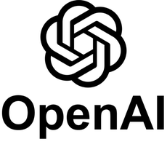





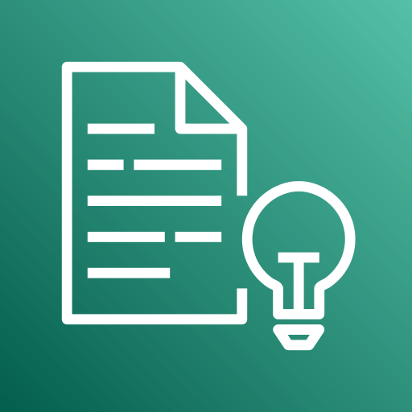


Intelligent process
Introduce generative and predictive AI into existing processes with low risk
Camunda Marketplace
Notes:
Out-of-the-box connectors from Camunda, our partners, and our community contributors enable you to introduce generative and predictive AI tools and services into existing processes with low risk
You can share reusable AI connectors to govern adoption through centrally managed AI services
Notes:
The icons on this slide represent (from left to right): OpenAI, Hugging Face, Azure OpenAI, Kubeflow, Google Cloud AI (also known as Vertex), Google Gemini, Amazon Comprehend, Amazon SageMaker, Amazon Bedrock
New connectors are being added to Camunda Marketplace on a regular basis

Slide 57
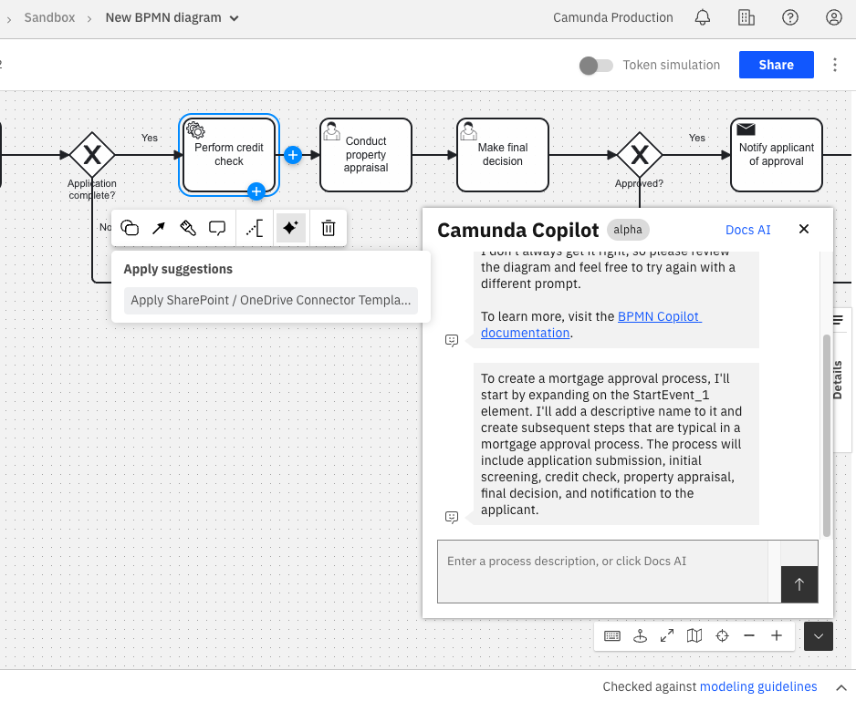
Camunda Copilot
Enable IT and business users to rapidly prototype process assets with AI-powered assistance
Copilot Capabilities
Interactive BPMN Copilot that creates a process model based on your description, process documentation, or even code
Suggestions for out-of-the-box connectors to use based on your task descriptions
FEEL Copilot that helps you write expressions for use in tasks and connectors
An AI-powered form generator that uses your input to create forms for user tasks
Play Mode Copilot that provides help for incidents when simulating processes
Documentation Copilot that answers your questions using Camunda’s technical docs and other resources
Notes:
Camunda Copilot has a variety of AI-powered capabilities that help both IT and business users rapidly prototype process assets such as BPMN process models, FEEL expressions (for working with data in processes), user task forms, and more
Note: The FEEL copilot is coming soon.

Slide 58
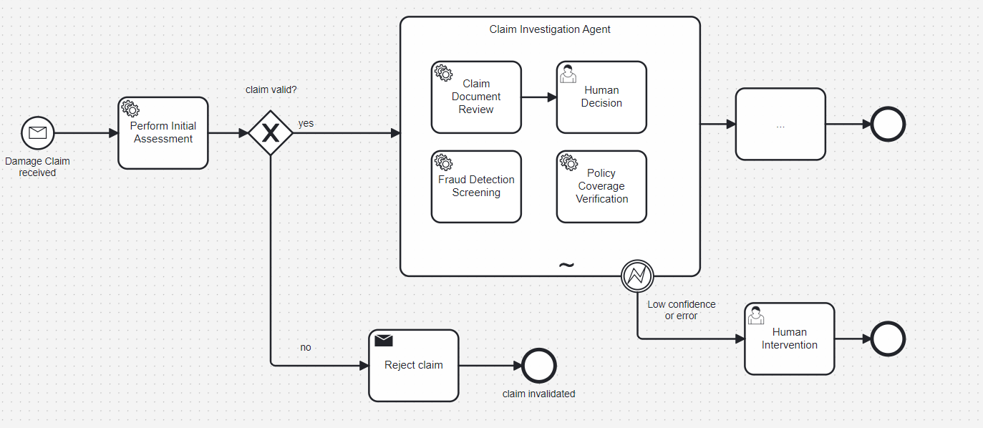
Autonomous AI
Uncover hidden value in your most critical end-to-end business processes
Ad-hoc next best action Use the BPMN ad-hoc sub-process to integrate Camunda’s next best action framework
Ad-hoc task definition
Define individual actions or processes within the BPMN ad-hoc sub-process
Human in the loop
If the confidence level is too low, involve a knowledge worker to help complete the work
Notes:
Camunda supports autonomous and semi-autonomous AI through the BPMN ad-hoc sub-process
This BPMN symbol doesn’t have a predefined sequence flow, making it ideal for modeling unstructured or dynamic processes
Camunda enables you to blend deterministic (predefined) and non-deterministic (ad-hoc) process orchestration, so you can:
Put guardrails around the use of AI agents, ensuring that they are used for unstructured work and not used for work that requires each step to be precisely defined ahead of time
Introduce agentic AI into processes with a low level of risk, and increase the use of agents over time

Slide 59
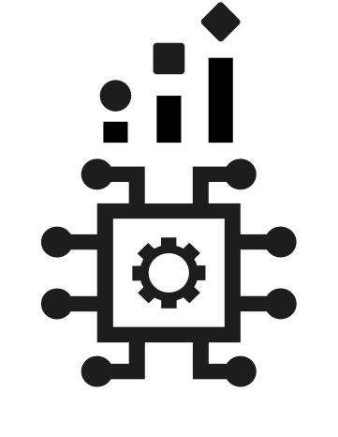
Build Your First AI Agent in Camunda
Follow this step-by-step guide to start developing agentic process orchestration with Camunda today.
camunda.com/blog/2025/02/building-ai-agent-camunda
Notes:
More information:
AI-enabled process orchestration (webpage)
Why AI Agents Need Orchestration (blog post)
Operationalize AI by Blending Deterministic and Non-Deterministic Process Orchestration (blog post

Slide 60
Camunda components
Notes:
These are additional slides that you can use as needed.

Slide 61
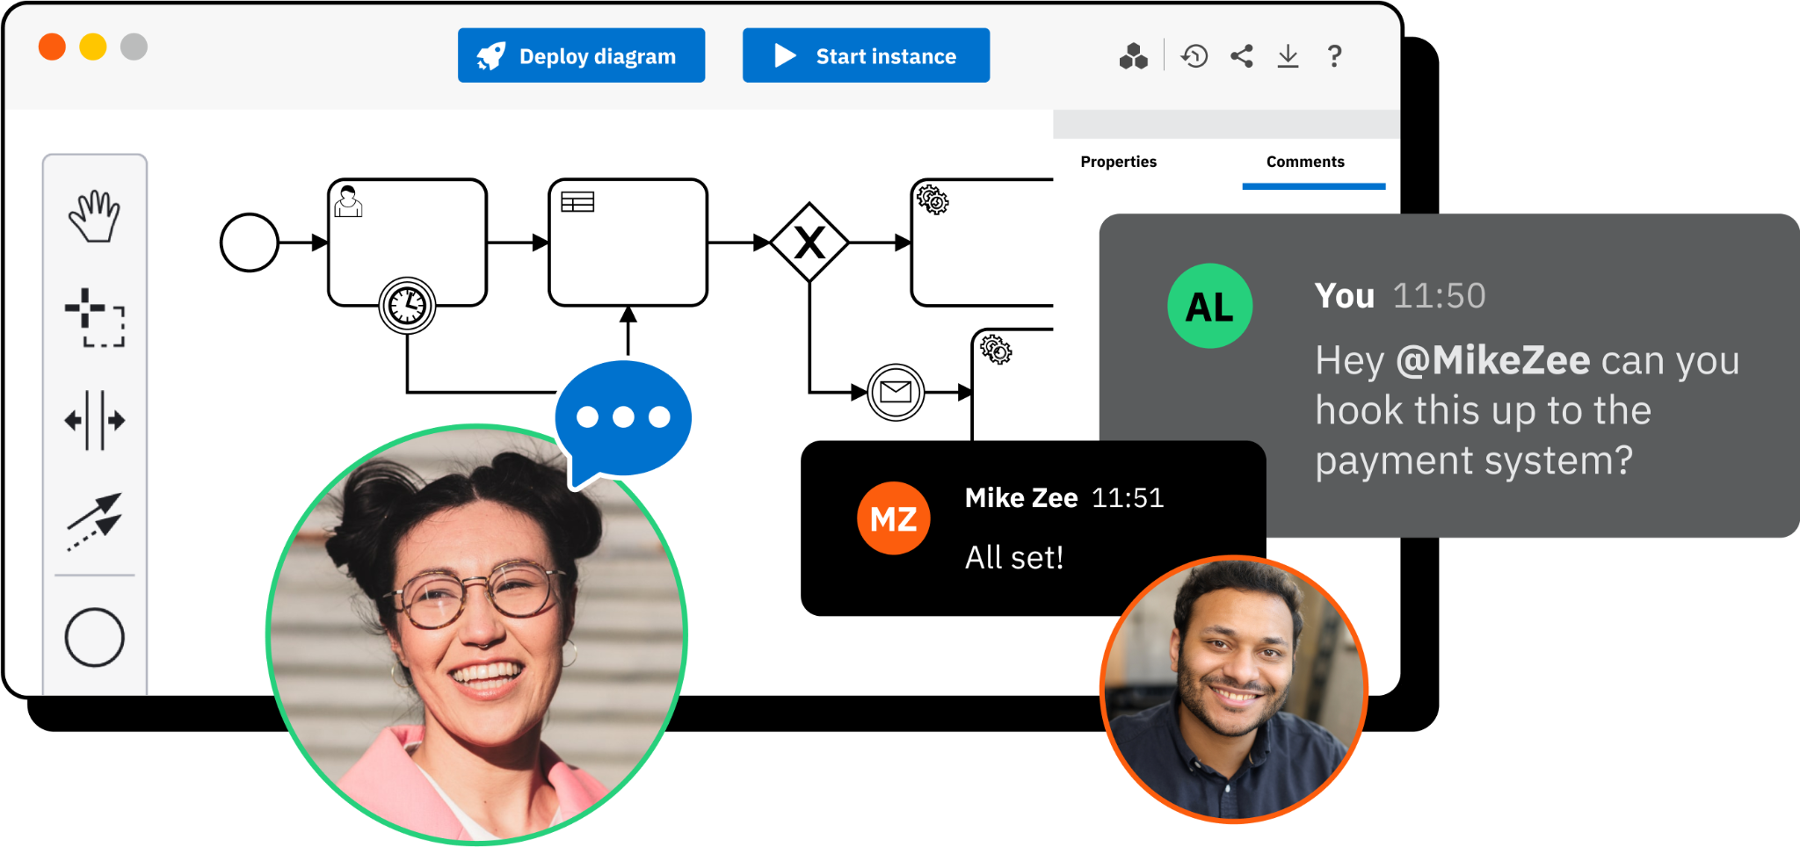
Modeler
Developers and business users collaborate to design processes, decisions, and forms.
Leverage one model for collaboration
Business stakeholders and software developers use the BPMN standard to model complex business processes, ending siloed, error-prone automation and introducing one process model.
Comment, share, and more
Take advantage of collaboration features such as comments, user tagging, shareable links, embeddable process diagrams, export to BPMN and image formats, and support for milestones.
Automate business decisions
Businesses run on decisions. Use the DMN standard to apply decision-making directly to the same process model. Empower business users to define and update decision tables without IT resources.

Slide 62
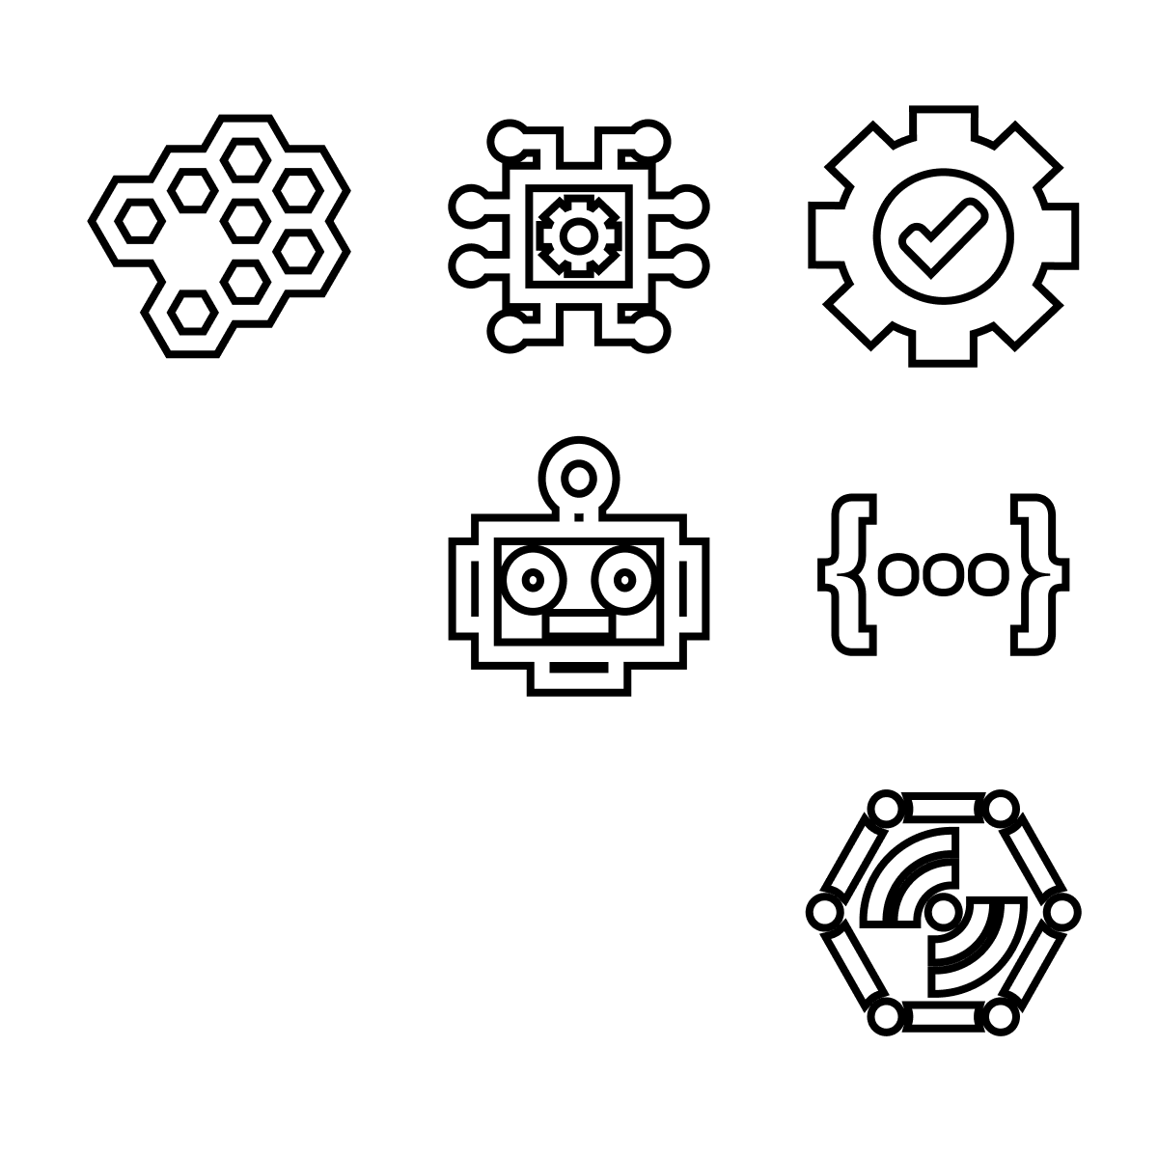
Connectors
Tame integration complexity with out-of-the-box connectors for popular technologies.
Connect to all the things
Camunda Marketplace offers pre-built connectors for task automation tools, AI/ML services, enterprise applications, collaboration tools, content management systems, and more.
Leverage bidirectional connectivity
Outbound connectors enable processes to trigger events in external systems or services, while inbound connectors enable processes to receive messages from external systems or services.
Customize a little, or a lot
Connectors provide a multilayer coding experience for every user. Copy a protocol connector to get started fast, or use the SDK for deep API access that allows you to build custom connectors.

Slide 63
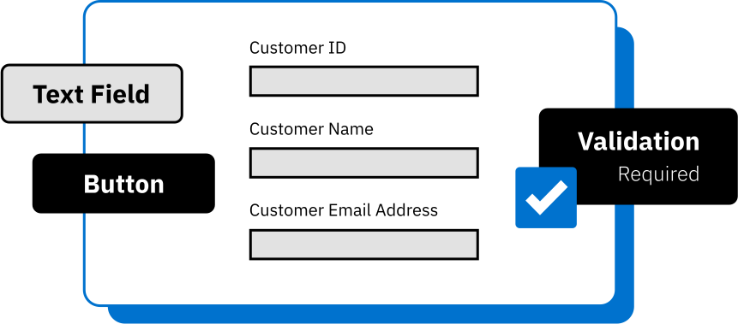
Form Builder
Drag-and-drop form creation for tasks that will be routed to knowledge workers.
Create rich user task forms
Leverage commonly used form controls such as text boxes, radio buttons, checkboxes, drop-down lists, embedded images and videos, and more. Use inline HTML and CSS for quick and easy styling.
Get formatting flexibility
Use conditional formatting, read-only fields, and input validation to ensure forms appear exactly as you want. Forms work seamlessly with Camunda Tasklist and can be embedded in your own apps.
Get started fast with AI assistance
Use natural language to describe your use case. The Camunda Copilot generates a form that you can customize and extend according to your unique business and technical requirements.

Slide 64
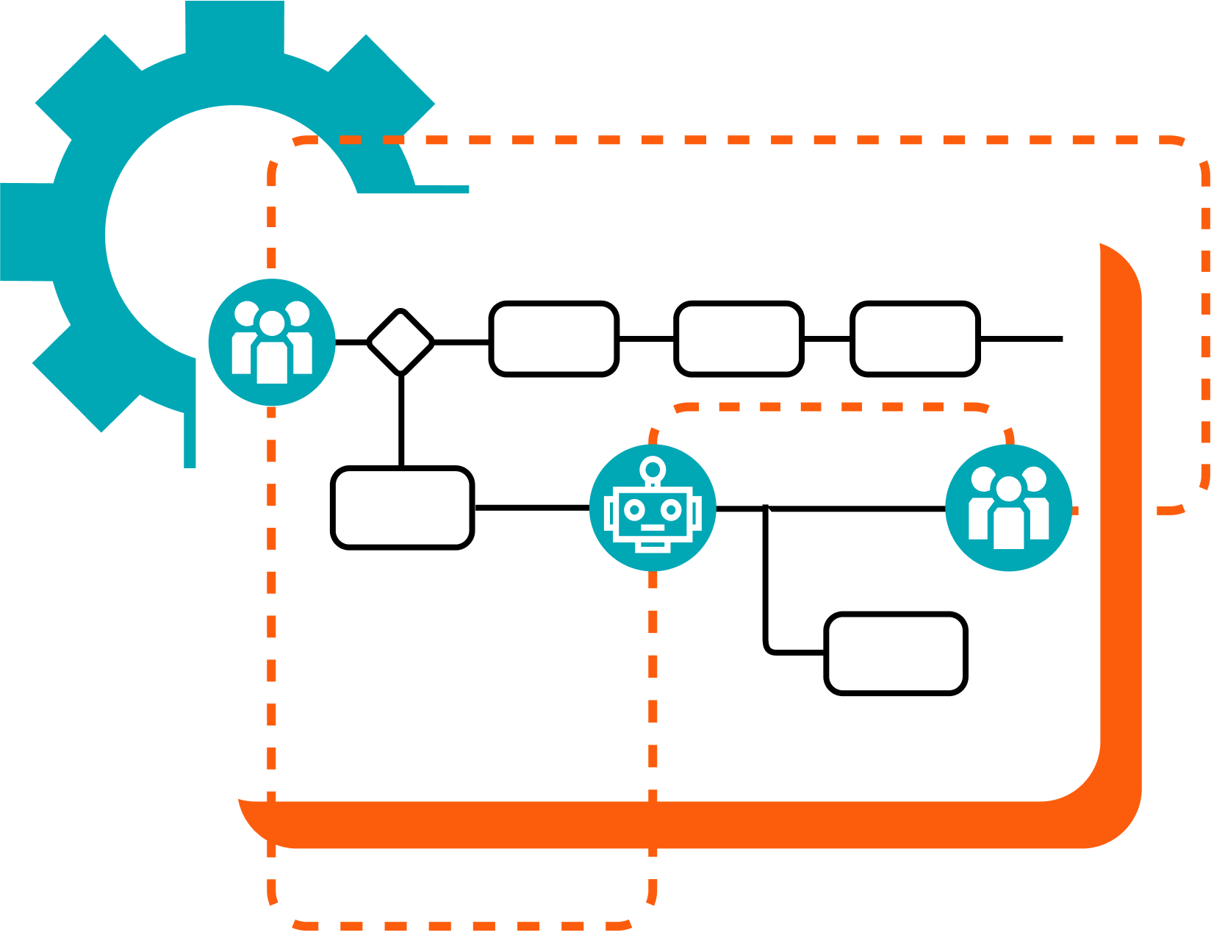
RPA
Integrate legacy systems and tools without an API into end-to-end business processes.
Orchestrate all types of bots
Orchestrate Camunda RPA bots and bots from other providers alongside APIs, AI/ML tools, human work, and more in a unified flow with a process model that everyone can understand and contribute to.
Minimize errors and downtime
Minimize task errors and leverage the power of process orchestration to avoid downtime or process failures that would otherwise negatively impact customers, suppliers, partners, and employees.
Get comprehensive analytics
Analyze and optimize all of your performance data in one unified view. Complete process-level and task-level analytics help teams identify bottlenecks and continuously improve.

Slide 65

Documents
Transform documents into instant insights with AI-powered document processing.
Automate document processing
Uncover the data hidden in your documents. Use AI-powered data extraction and automated classification to gain insights from structured, semi-structured, and unstructured documents.
Reduce manual work and errors
Save time and money by automatically extracting critical data so it can be used in processes. Enable knowledge workers to focus on situations where data confidence is low or on more strategic work.
Use your preferred providers
Use your preferred IDP providers and services thanks to Camunda’s composable architecture. Avoid vendor lock-in and swap IDP providers without overhauling business process models.

Slide 66

Copilot
Get started fast with a variety of copilot features that turn your ideas into reality.
Create, migrate, and iterate
Provide your documentation, raw code, process models from legacy BPM tools—or just describe your use case and the BPMN copilot helps you iteratively design the process you need.
Handle data with ease
Get help with writing expressions in Friendly Enough Expression Language (FEEL) so you can access variables and calculate values for use in BPMN symbols and Camunda connectors.
Use natural language to create forms
Quickly create forms for tasks that will be done by knowledge workers. Simply describe your use case and layout preferences, and the form copilot does the work for you.

Slide 67
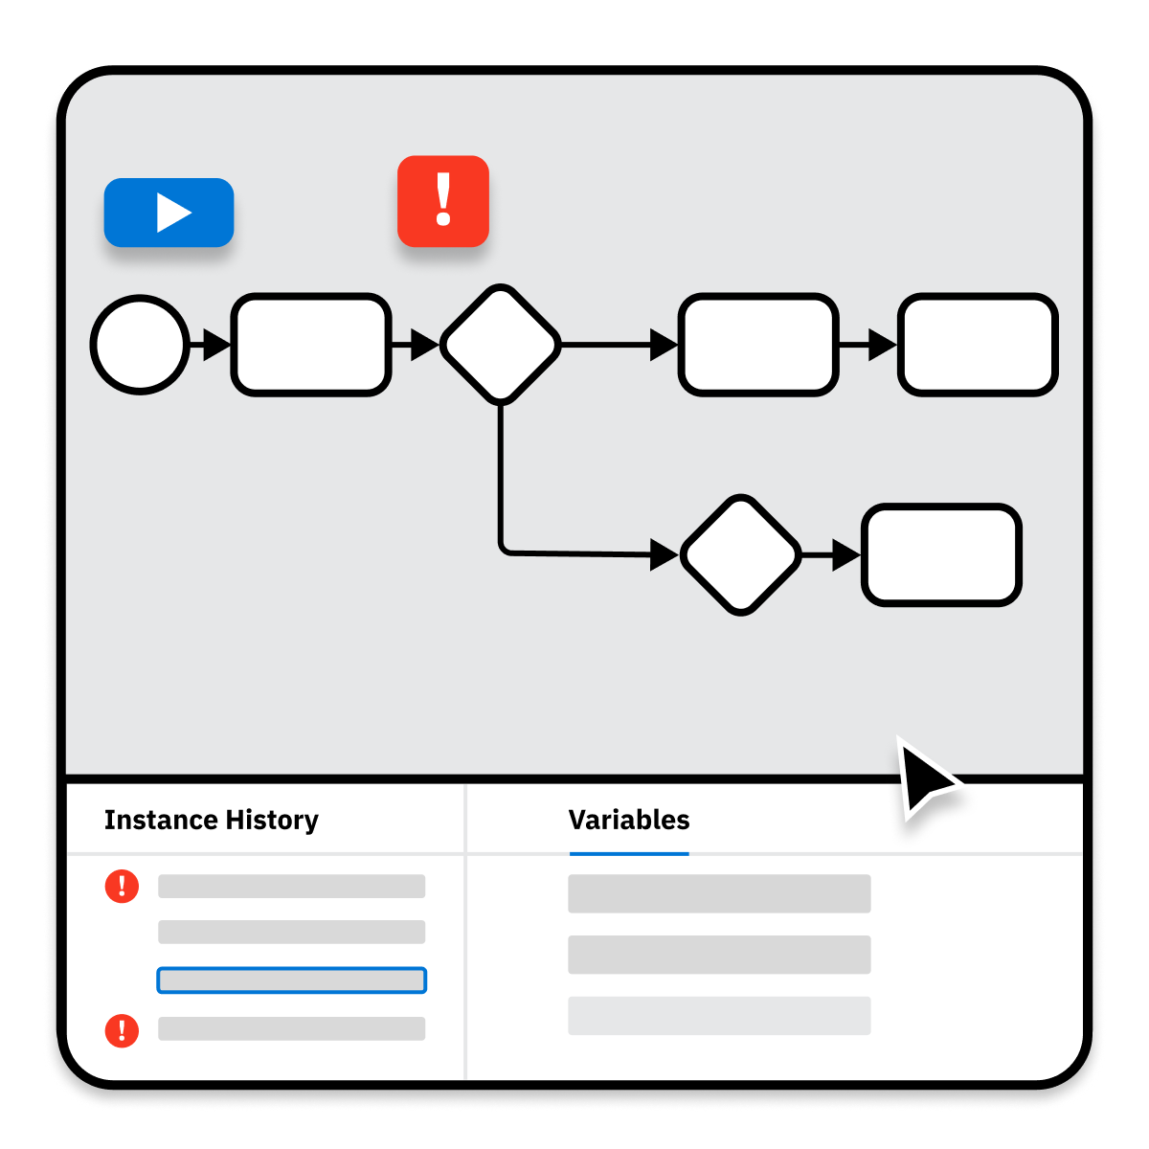
Play Mode
Enable all users to simulate processes without affecting production environments.
Leverage one model for testing
Run simulations of the exact BPMN process model that you build in Camunda Modeler. Visualize the happy path and gain a better understanding of the way the process will work at runtime.
Spin up a test environment fast
Play Mode automatically spins up a playground environment and deploys your process to it. Play Mode doesn’t affect running processes, production data, or usage limits.
Ensure you’re ready for errors
Simulate error conditions and unhappy paths to ensure the process reacts as expected. For example, if an API or an external system fails to respond to a request, does the process fall back to a backup flow?

Slide 68
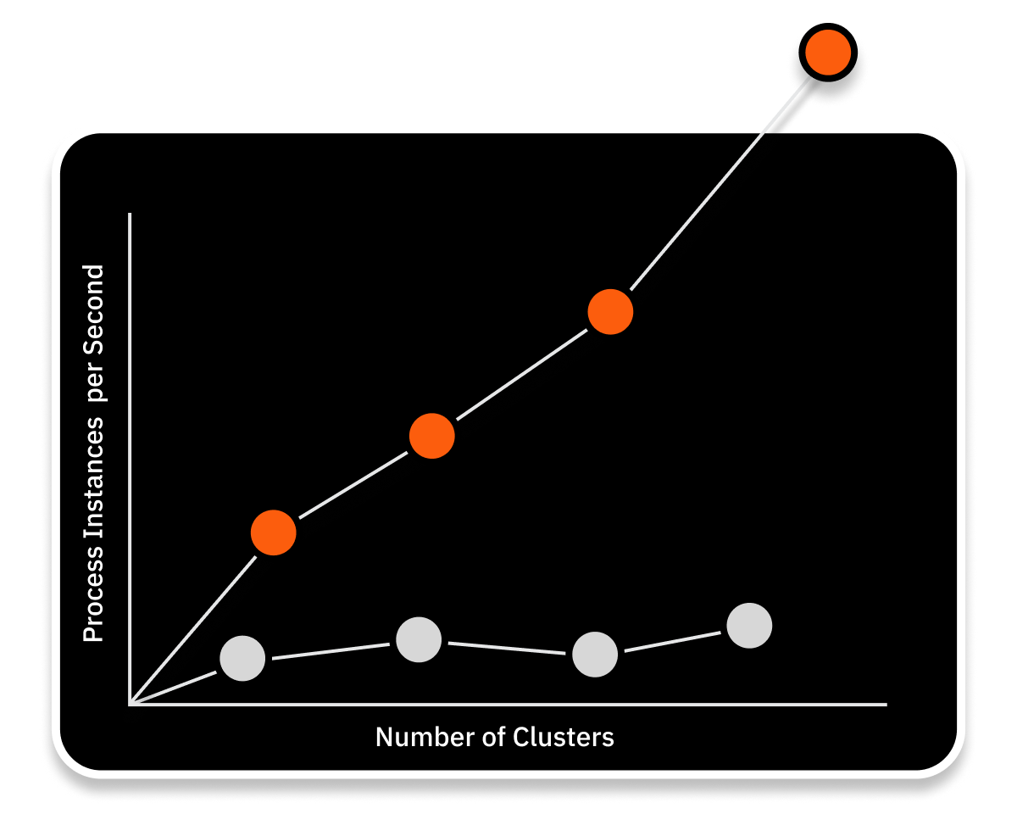
Zeebe
Cloud-native event streaming for unparalleled scale and resilience.
Execute with unparalleled scalability
Camunda Zeebe is a distributed system without a central database, so it doesn’t have a performance bottleneck. It’s easy to distribute processes across clusters to achieve high throughput.
Ensure business continuity
Zeebe provides enterprise-grade resilience by distributing data across all brokers in a cluster with storage directly on the server filesystem. If a broker goes down, another can replace it with no data loss.
Develop in any programming language
Use out-of-the-box clients or your preferred programming language to implement job workers that send commands to Zeebe to deploy processes and execute business logic.

Slide 69
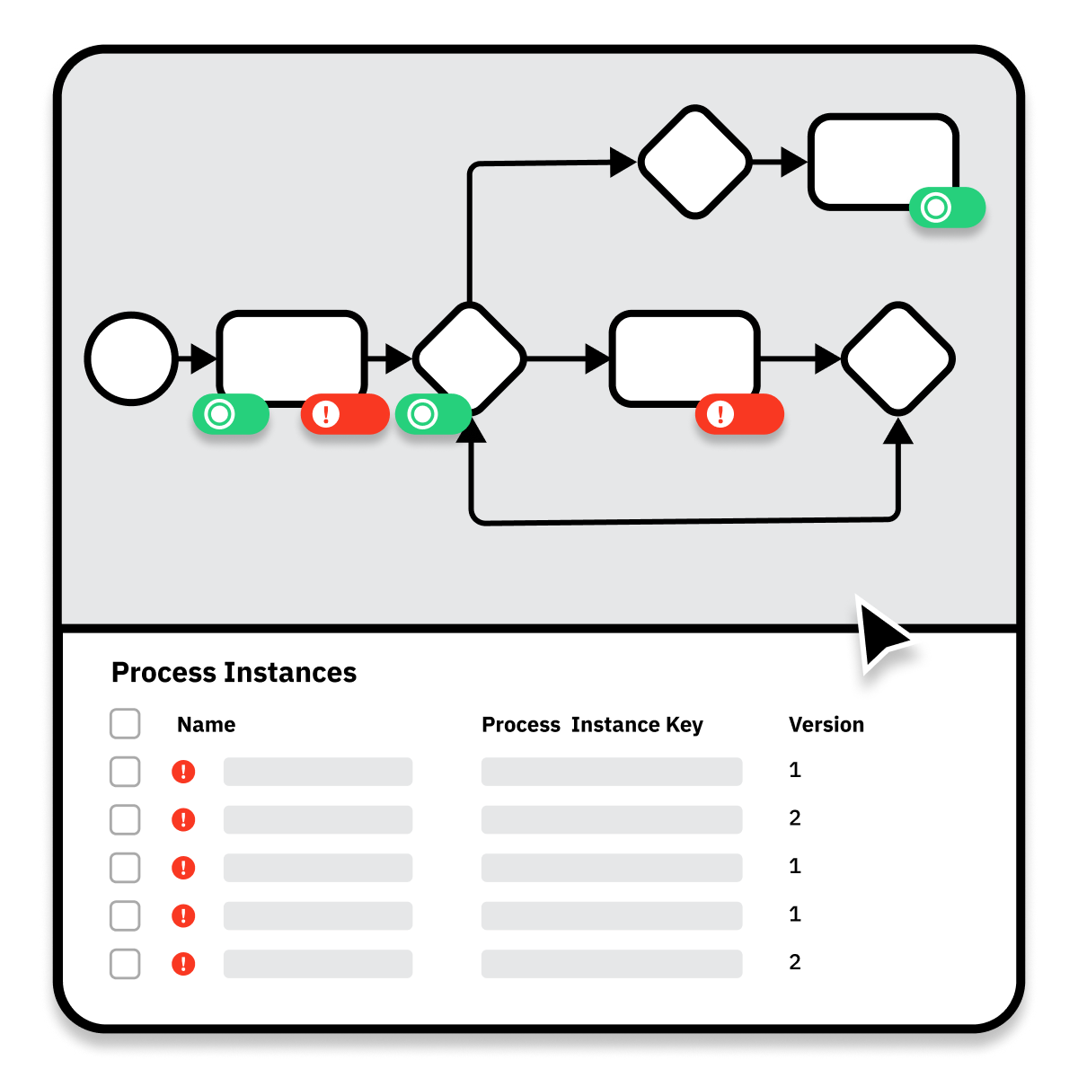
Operate
Manage and troubleshoot processes with one model for process visualization and management.
Leverage one model for management
See process instance status and data in the context of the BPMN process model. Understand what’s happening with your processes without digging through logs or running traces.
Analyze and resolve incidents
See incidents at a glance and quickly identify which processes are stuck. Troubleshooting tools help operators identify the root cause and take action; for example, by changing variables or moving tokens.
Update processes without fear
Business processes change and evolve. Migrate running process instances to a new version of the BPMN model without interrupting the end user experience, losing data, or losing state persistence.

Slide 70
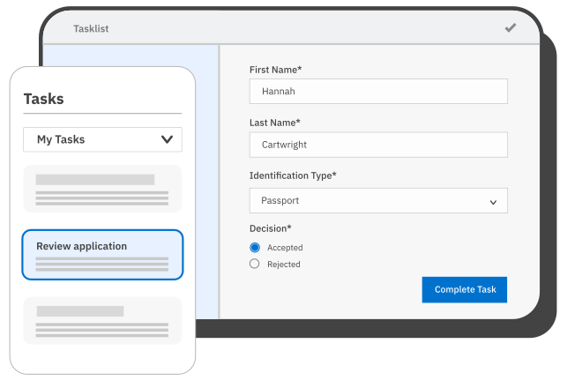
Tasklist
Web app for human work, with a comprehensive API for custom front-end applications.
Instant UI for any process
Tasklist works out-of-the-box with any Camunda process that includes user tasks. You can opt to customize the Tasklist UI using our drag-and-drop Form Builder with built-in AI assistance.
Route tasks intelligently
Combine Tasklist with our AI-enabled process blueprint to leverage AI and decision automation for task routing. Ensure knowledge workers only handle the tasks they need to.
Bring Camunda UI into your apps
Combine Camunda-based forms with the front-end applications your users are familiar with. Use the Tasklist API to integrate any front end with a Camunda back end for process orchestration.

Slide 71
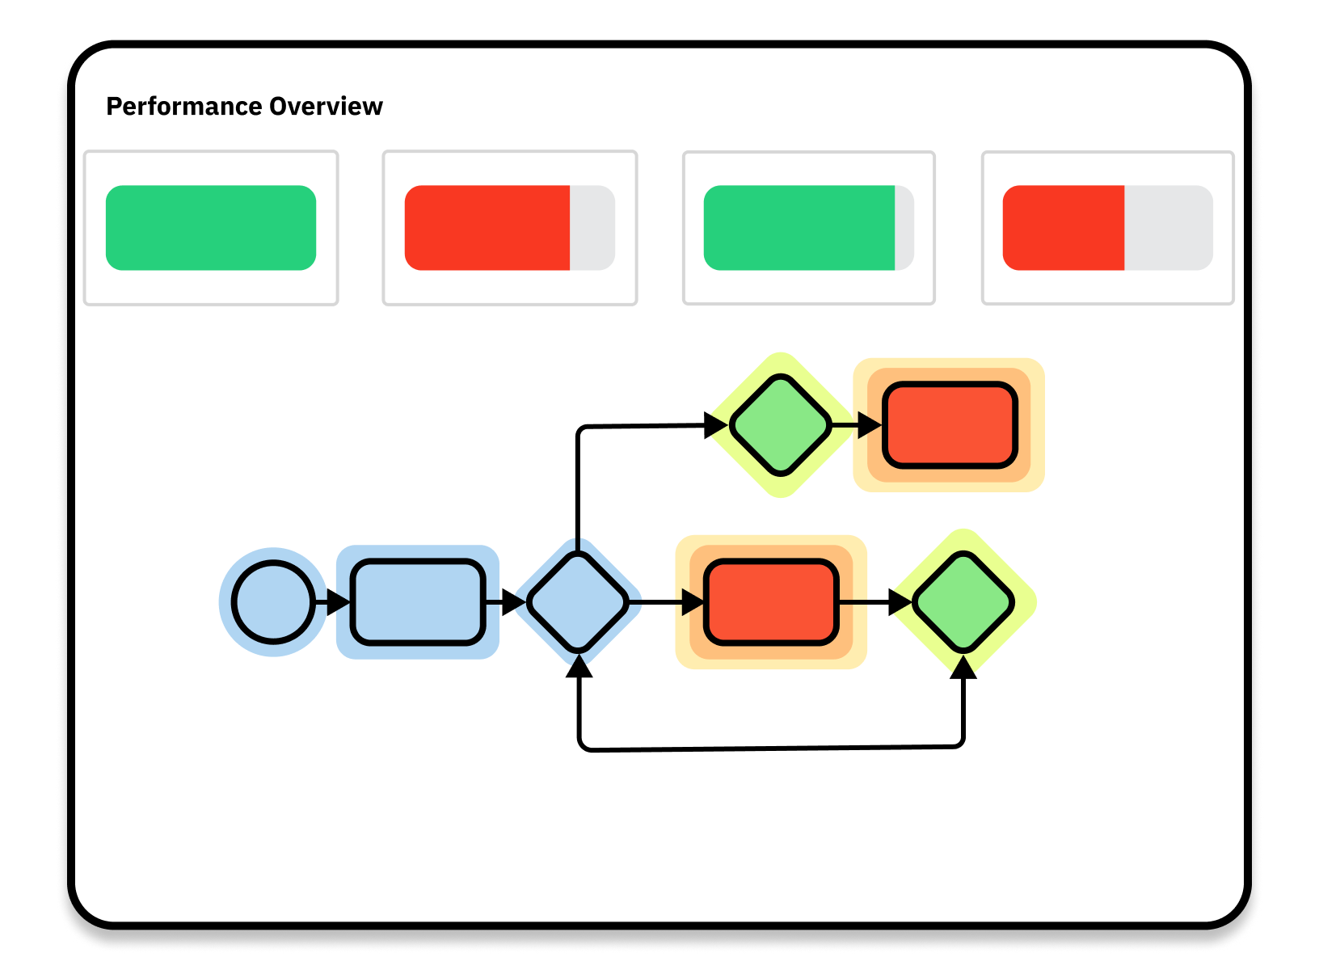
Optimize
Teams have the insights to fix the highest ROI problems for business processes.
Leverage one model for visualization
Show the reality of what’s working in your process – and what needs improvement – using detailed dashboards created with your process data. See everything in the context of your process models.
Customize for your business needs
Create and customize reports and dashboards, or start with reports that are auto-generated when you deploy a process. Use built-in business KPIs or define your own and set up alerts.
Analyze every piece of process data
Export process execution data in a format that’s ready to import into popular open source machine learning tools such as scikit-learn and pandas.

Slide 72
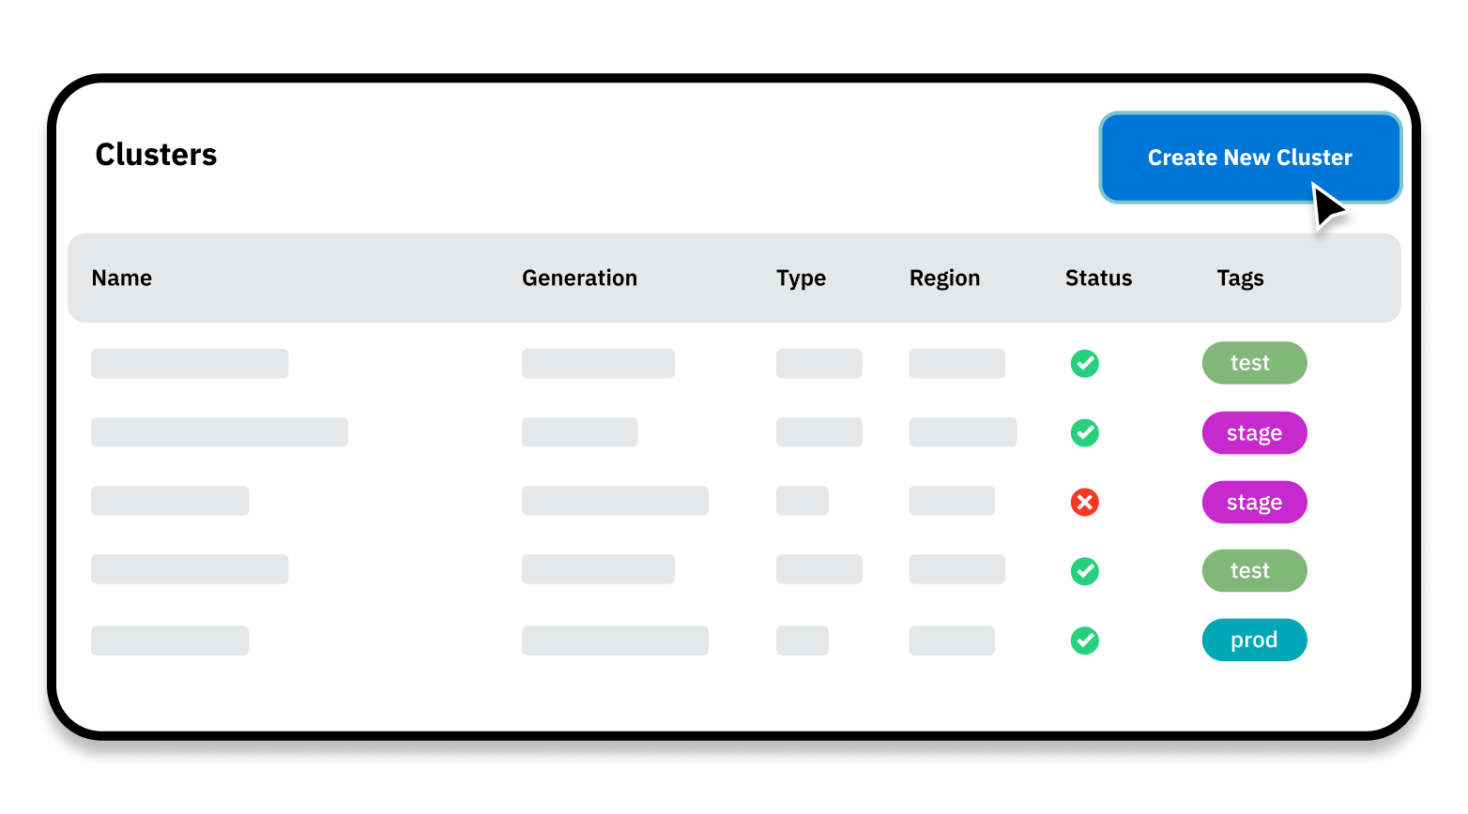
Console
Full governance over your Camunda installation and usage, SaaS or Self-Managed.
Create and manage clusters
Create clusters to scale process execution capacity horizontally. Monitor the health of clusters and tear down those that are no longer needed.
Upgrade with a few clicks
Get notifications when a new version of Zeebe is available and upgrade clusters with a few clicks. No need to run upgrade scripts.
Manage app and user permissions
Take control of authentication and authorization for external applications and APIs. Add and remove users, assign roles, and configure permissions.

Slide 73
Camunda connectors
Notes:
These are additional slides that you can use as needed.

Slide 74




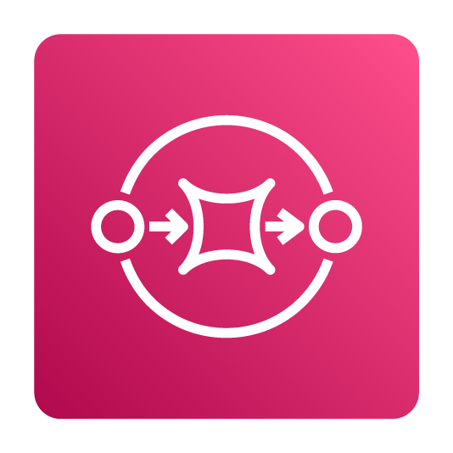














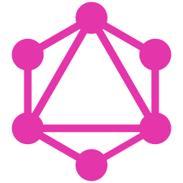
Orchestrate anything with Camunda connectors
A variety of out-of-the-box connectors are available for you to use, customize, and extend
Kubeflow
Kafka
GitLab
GitHub
SendGrid
Amazon SQS
OpenAI
Robocorp
Slack
AWS Lambda
Amazon Bedrock
Google Cloud AI
Microsoft Teams
Amazon SNS
Microsoft 365 Outlook
UiPath
Google Drive
RabbitMQ
Twilio
Microsoft Power Automate
More available on Camunda Marketplace
Automation Anywhere
GraphQL
Hugging Face
Notes:
Connectors are a powerful way to connect Camunda to other tools and systems in your technology stack
They help you communicate with any tool or system, reducing the time it takes to orchestrate business processes
These are just a few examples of the connectors that we deliver out of the box, in addition to connectors that are built and maintained by our partners and community members

Slide 75

Accelerate connectivity with Camunda Marketplace
A trusted source of integration technologies from Camunda, our partners, and our global user community
Browse a wide variety of connectors for enterprise applications, popular technologies, productivity tools, AI/ML services, and more
Install in your Camunda SaaS account with a few clicks or download for easy installation in Camunda Self-Managed
Customize and extend connectors by adjusting properties, setting defaults, and adding functionality
Share approved connectors across projects or teams to encourage reuse within your organization’s guardrails

Slide 76
Camunda connector architecture
Intuitive, scalable, and customizable multilayer coding experience for every user
Out-of-the-box connector
Configurable connector templates
Simplicity
Flexibility
Protocol connector
Connector SDK
Notes:
This slide illustrates our connector architecture, which provides a multilayer coding experience for every user
The connector SDK provides the foundation for all out-of-the-box connectors and custom connectors
Protocol connectors represent the base technology of a connector (such as HTTP)
Configurable connector templates build upon the protocol connectors to provide functionality that is required for a specific use case
And Camunda’s out-of-the-box connectors provide all of the functionality you need to orchestrate specific technologies (such as Kafka, Slack, and more)
Notes:
More information https://camunda.com/blog/2023/06/architecture-connectors/

Slide 77
Camunda robotic process automation
Notes:
These are additional slides that you can use as needed.

Slide 78
Managing RPA without process orchestration presents many challenges
Common RPA Challenges
RPA With Camunda
Fragmented automation is implemented via isolated RPA bots without an overview of the end-to-end business process
Fragmentation makes it hard to monitor, manage, and optimize RPA bots
It’s difficult to manage the cost and complexity of multiple RPA tools
A proliferation of RPA bots can result in technical debt and vendor lock-in that’s hindering your ability to adapt to new business requirements
Move beyond isolated bots to orchestrate end-to-end business processes that combine bots, APIs, microservices, AI/ML, and more
Gain process visibility so you can fix broken processes and identify process improvements that will have the highest ROI
Reduce costs and complexity by only using the RPA functionality you truly need
Give teams flexibility to address new business requirements through a scalable, composable process architecture

Slide 79






Get the most out of RPA with process orchestration
Automate processes from end to end
Deliver automation projects faster
Integrate bots seamlessly
Orchestrate RPA bots, AI/ML, APIs, microservices, legacy systems, human work, and more in a unified process flow
Rapidly implement task-level and process-level automation for the core processes that make up your business
Mix-and-match bots from different vendors and enhance task automation without re-implementing processes
Minimize errors and downtime
Align knowledge workers and bots
Get comprehensive analytics
Minimize task errors and leverage orchestration to avoid downtime that would impact customers
Automate repetitive tasks, boost knowledge workers’ productivity, and enhance team efficiency
Complete process-level and task-level analytics help teams identify bottlenecks and continuously improve

Slide 80
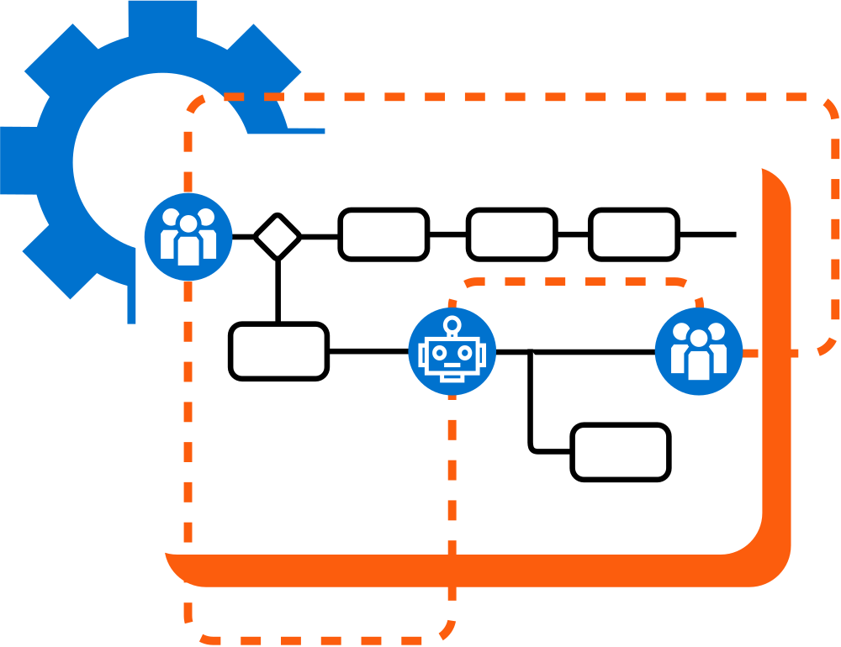
Get the most out of RPA with process orchestration
Integrate with legacy systems
Automate tasks on systems that don’t offer an API as part of end-to-end business processes. Reduce or even eliminate repetitive and error-prone manual work on legacy software.
Automate across all endpoints
Automate complex business processes from start to finish by integrating RPA bots, microservices, AI/ML tools, enterprise applications, human work, and more in an end-to-end flow.
Scale up as demand increases
Optimize business processes by deploying RPA where it has the most value today and by swapping out bots for APIs without having to redesign your processes.

Slide 81

How Camunda RPA works
Resources
Camunda Zeebe
(execute processes)
Camunda Operate
(monitor processes)
Process
(.bpmn)
Bot script
(.rpa)
deploy
execution events
view script errors
create/edit
RPA jobs
report job success or failure
fetch bot script from Zeebe
Camunda Modeler
(design processes)
Camunda Java client
Camunda bot runtime
(desktop application)
RPA connector template
RPA connector
RPA library
run script for local testing
RPA bot script cache
RPA script editor

Slide 82
Camunda intelligent document processing
Notes:
These are additional slides that you can use as needed.

Slide 83
Document-dependent business processes need process orchestration
Common IDP Challenges
IDP with Camunda
Fragmented automation is implemented via isolated document tasks without an overview of the end-to-end business process
Fragmentation makes it hard to monitor, manage, and optimize document-dependent business processes
It’s difficult to manage the cost and complexity of multiple tools for document handling, processing, and analysis
An inflexible approach to IDP prevents teams from adapting to changing business and compliance requirements
Move beyond isolated IDP implementations to orchestrate end-to-end business processes that combine documents, APIs, AI/ML, and more
Gain process visibility so you can identify ways to improve document processing
Reduce costs and complexity by only using the IDP functionality you truly need
Give teams flexibility to address new business requirements through a scalable, composable process architecture

Slide 84


Transform documents into instant insights
Automate processes from end to end
Deliver automation projects faster
Integrate documents seamlessly
Automate document handling and processing in a unified process flow with RPA, AI/ML, microservices, and more
Rapidly automate document- based processes to reduce manual effort, increase efficiency,and reduce errors
Plug-and-play document handling and processing from multiple IDP providers in a unified business process
Get maximum flexibility
Align human and machine workers
Comprehensive analytics
Use your preferred IDP providers and services thanks to Camunda’s composable orchestration architecture
Automate repetitive tasks, boost knowledge workers’ productivity, and enhance team efficiency
View document execution data in the context of business processes to better understand performance
Notes:
Notes:
IDP = Intelligent document processing
AI/ML = artificial intelligence and machine learning
LLM = large language model
NLP = natural language processing
OCR = optical character recognition
ICR = intelligent character recognition

Slide 85
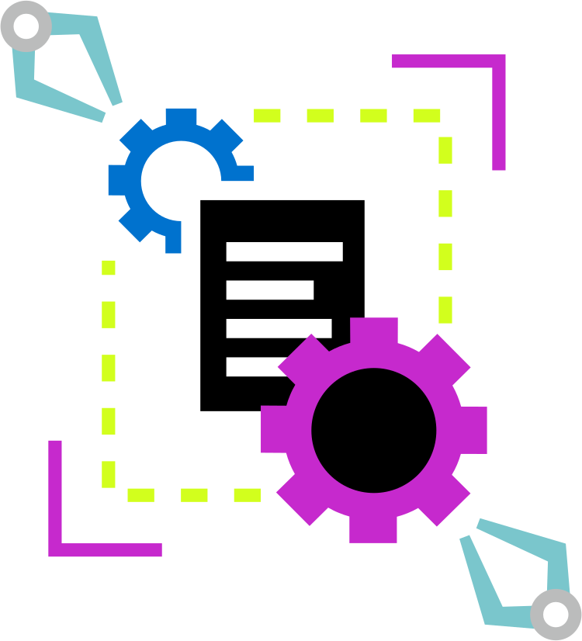
Transform documents into instant insights
Get process visibility and control
Collaborate, deploy, monitor, manage, and improve complex business processes with all document processing tasks included as part of an end-to-end process flow.
Native integration with Camunda
Plug-and-play document intelligence into business processes without integration effort. Mix-and-match built-in Camunda IDP with other document processing tools and services.
Composable architecture
Leverage Camunda integrations for maximum flexibility with IDP providers. Use multiple providers and switch between providers without redesigning business processes.

Slide 86
How Camunda IDP works
Resources
Camunda Zeebe
(execute processes)
AI provider services
(process documents)
store documents
Document
(.pdf)
Document
(.jpeg)
use models
AI models
get extracted key-value pairs
Examples: AWS Bedrock, Google Vertex AI
upload
deploy
Camunda Web Modeler
(set up IDP)
Camunda Modeler
(design processes)
Extraction
Define taxonomy
Choose AI model
Classification
Select doc types
Choose AI model
Document automation
Extraction
use created templates
incoming doc
Document extraction template
Document automation template
Classification
Output variables

Slide 87
Camunda packaging and deployment
Notes:
These are additional slides that you can use as needed.

Slide 88
Camunda SaaS Offering
We host, guarantee uptime, and handle setup and maintenance
Free
Enterprise
All process modeling features available
Community support
Full feature set available
Production and non- production clusters available
Define your usage plan
8x5 or 24x7 support
Enterprise SLA and legal terms
Training and consulting available
Notes:
With Camunda 8 SaaS, we host the software and we guarantee uptime, with high availability thanks to geo-replication
We also take care of all infrastructure setup and maintenance so your IT teams can focus on building value rather than building and maintaining infrastructure
Our SaaS infrastructure is optimized for Camunda, ensuring maximum uptime, consistent low latency, and high standards of security

Slide 89
Camunda Self-Managed Offering
You host and are responsible for uptime, setup, and maintenance
Free
Enterprise
Source-available license
Production usage of Desktop Modeler allowed
Non-production usage of all other components allowed
Community support
Commercial agreement
Production usage of all components allowed
8x5 or 24x7 support
Customer success management
Training and consulting available
Notes:
With Camunda 8 Self-Managed, you host the software, and there is no uptime guarantee from Camunda
Your team is responsible for infrastructure setup, performance, security, redundancy, and maintenance of both hardware and software
Self-Managed Free is free forever, with production usage of Modeler and non-production usage of all other components
Self-Managed Enterprise includes production usage of all components

Slide 90



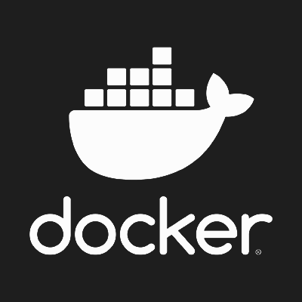




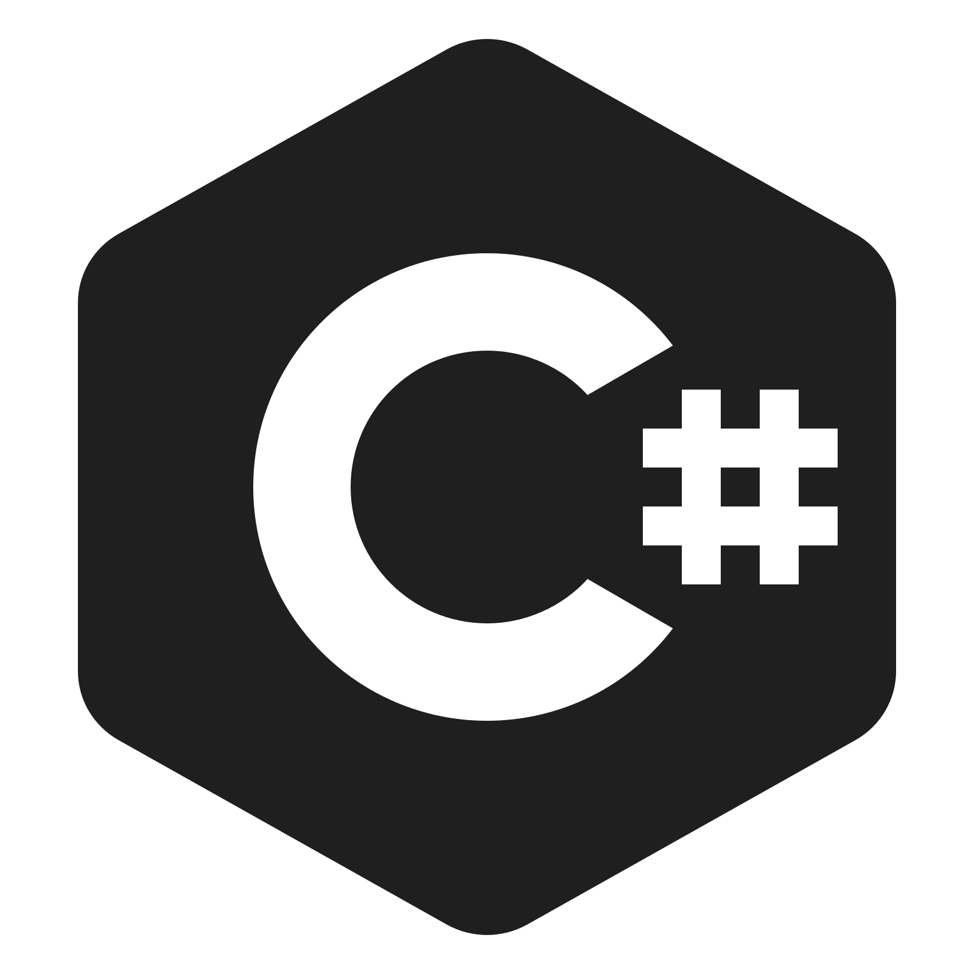





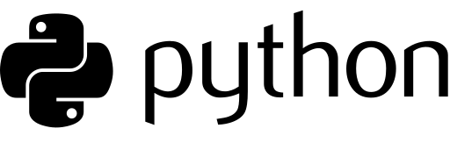


Code & deploy in your preferred language and tooling
Run on your preferred platforms
Across all endpoints
Human work
AI/ML
Business rules
Microservices
RPA
API
IoT
Systems (legacy + homegrown)
Notes:
Camunda can orchestrate business processes from end to end across a wide variety of process endpoints such as APIs, AI tools, and more
Because business processes are complex, we believe it’s critical to enable software developers and other IT users to deliver process automation projects using the programming languages, tooling, and platforms they prefer – whether on premises or in the public, private, or hybrid cloud
Notes: The icons on this slide represent the following technologies:
White box = Java, Ruby, VSCode, IntelliJ, Azure DevOps, C#, Python, Eclipse, JUnit, Jenkins
Orange box = Kubernetes, Docker, on-premises, AWS, Google Cloud, Microsoft Azure

Slide 91
Camunda Components and Licenses
Camunda
Replication cluster (RAFT)
Camunda Desktop Modeler
Zeebe
Own persistence
(event log)
Camunda Web Modeler
Connect via Zeebe gateway
Zeebe
client
Camunda Console
Streaming exporter
BPMN, DMN, & forms
Elasticsearch
Process solution
Tasklist
Operate
Optimize
Kubernetes Operator (SaaS)
Source-available license
Helm charts (Self-Managed)
Identity
Open source license
Closed source
Keycloak
Cluster
Third-party component
Notes:
These are the components that make up Camunda Platform and the type of license required to use them
Components in orange have a source-available license, while components in green are open source
We also use some third-party components, such as Elasticsearch and Keycloak

Slide 92



Camunda SaaS Infrastructure
Camunda
Console
Logs
User
(browser)
Camunda
cluster
Monitoring
Apps
(client)
Identity & access management (IAM)
Billing
Kubernetes Engine
Notes:
Camunda 8 is available in a SaaS offering that Camunda manages and has optimized for high resilience and low latency to ensure fast, reliable process execution
We rely on industry-leading technologies for identity and access management, Distributed Denial of Service (DDoS) protection, load balancing, and monitoring
In detail:
Components inside a cluster are Zeebe, Operate, Tasklist, Optimize, and Elasticsearch
Components outside a cluster are Web Modeler and Camunda Console
Identity and access management (IAM) is provided by Auth0
Protection from distributed denial-of-service (DDoS) attacks is provided by Cloudflare
Load balancing is implemented in NGINX
We use Prometheus for monitoring system health

Slide 93





Camunda SaaS Security and Compliance
ISO/IEC 27001 certified
SOC 2 Type 1 & 2 certified
Cloud Security Alliance member
General Data Protection Regulation compliant
Assessed by the Trusted Information Security Assessment Exchange
Notes:
To learn more about our security, compliance, and privacy practices, visit the Camunda Trust Center at https://camunda.com/trust-center/
You can request a Customer Assurance Package, which provides detailed security information to help you complete vendor security assessments

Slide 94
Camunda consulting and education services
Notes:
These are additional slides that you can use as needed.

Slide 95
Expert guidance on your process orchestration journey
Camunda post-sales consulting services are here to guide you from day one
Camunda Service Offering
Introduce Camunda to your organization seamlessly
Education Services
Project Success Acceleration (ProSA)
Technical Account Management
Camunda 7 to 8 Migration Guidance
Process Orchestration Adoption Framework
Successfully adopt Camunda process orchestration and automation at scale
Maximize the value of process orchestration and automation for your organization

Slide 96





Consulting Services Overview
Business
Value
Project
Scope
Enable
Guide
Operate
Scale
Build foundation & Empowerment through Knowledge
Accelerate through tailored expertise and navigation
Ensure stability & efficiency through Continuous Oversight
Adopt & grow through Methodological Excellence
Company-wide Scope

Slide 97




Consulting Services in Detail
Technical Account Management
Project
Scope
Education Services
„Project Success Acceleration“ Onboarding
Business
Value
Company Scope
Expert On Demand
Camunda Partner Services
Typically 6-9 months
Evaluation
Kick-Off
Go Live
Process Orchestration Adoption Framework

Slide 98
Camunda Service Offerings
Camunda post-sales consulting services are here to guide you from day one
Education Services
Consulting Services
Technical Account Management
Seamless enablement for all Camunda adopters anytime, anywhere
Maximize outcomes for your Camunda project through expert guidance
Your trusted advisor for organisation-wide adoption
On demand (24/7)
Instructor-led (bespoke)
Courses for all stakeholders
Multiple languages available
Project Success Acceleration (ProSA)
Technical onboarding
Implementation guidance
Risk mitigation
Go-live check
Expert On Demand (EoD)
Custom scope consulting
Technical program management
Technical centralization and evolution guidance
Use case discovery and evolution guidance
Value management advisory

Slide 99



Customer & Partner voices about ProSA
“We have teamed with Camunda's ProSA (Project Success Acceleration) program on three separate clients across the financial, retail, and transportation industries. Our experience has been overwhelmingly positive. [...] We actively request our clients to utilize their ProSA consulting hours at various, strategic checkpoints during our projects. [...] By doing so we de-risk the process for our clients. Often we uncover techniques that allow us to compress project timelines and allow the inclusion of new features within the same delivery windows”
“Overall, our experience has been very positive. Specifically, the sound expertise related to application configuration, system sizing and related scalability was directly and efficiently assisting the internal team’s efforts to provide an appropriate Camunda set-up which balances the overall D7 scalability requirements versus the costs for the related cloud consumption. In that sense our partnership with ProSA significantly contributed to the know-how build-up of the internal team and lowered the pressure on this team to a large extent”
“Overall, the partnership with Camunda Consulting helped us significantly in the design of new processes and increasing their efficiency. Furthermore, it enabled us to considerably expand the expertise of our Camunda and IT teams to find new innovative solutions.”

Slide 100
Camunda use cases
Notes:
These are additional slides that you can use as needed.

Slide 101
Popular Camunda use cases
IT Initiatives
Technical Use Cases
Business Processes
Building a centralized process automation platform
Replacing a legacy business process management suite (BPMS)
Replacing homegrown workflow technology
Moving applications to the cloud
Human workflow automation
Microservices orchestration
RPA bot orchestration
Decision automation
Document management
Customer onboarding and data management
Order management
Claims management
Loan origination
Risk management and underwriting
Notes:
We like to look at the usage of our software in three dimensions:
Cross-department IT initiatives like replacing legacy software or moving applications to the cloud
Technical problems that need to be solved, like how to orchestrate microservices or how to automate decisions
And core business processes that are often undergoing digital transformation, like customer on-boarding, insurance claim management, loan origination, etc.
Here you can see some examples, but we have customers that use Camunda software for many different types of initiatives and use cases

Slide 102
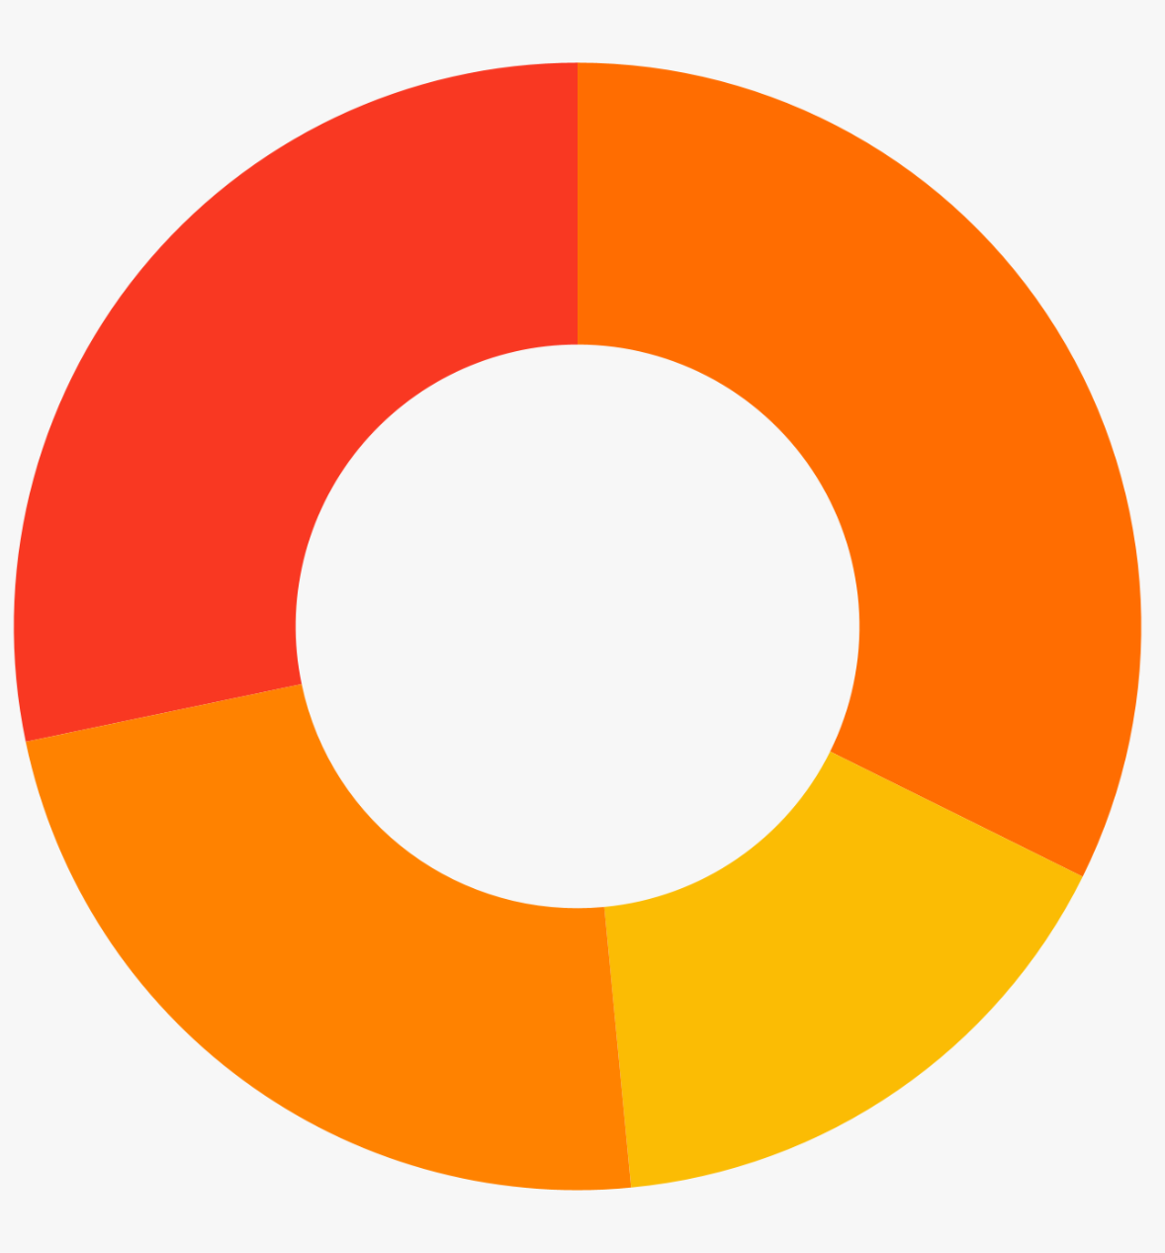
IT initiatives
How Camunda
changed the game:
British Telecom processes 5x more orders every week with a 20% reduction in costs and a 20% increase in NPS score after replacing a complex and limiting homegrown process automation system with Camunda.
Use Camunda as the engine to power modernization and centralization
Building a centralized process automation platform
28%
Moving to the cloud, modernizing applications, and other initiatives
32%
Replacing homegrown workflow technology
23%
17%
Replacing a legacy BPMS
Survey of customer projects, n = 864
Notes:
We have many customers that have used Camunda as the foundation for a centralized process automation platform that different teams throughout the organization can use in their projects
We also see that many organizations are focusing on modernizing their applications and moving workloads to the public, private, or hybrid cloud
We also have customers that are focused on modernizing their business processes by replacing BPM products or homegrown technology that no longer meets their business needs
Notes:
The data on this slide was last updated on 13 December 2024
British Telecom story: https://camunda.com/blog/2024/12/bt-group-openreach-simplify-operations/

Slide 103
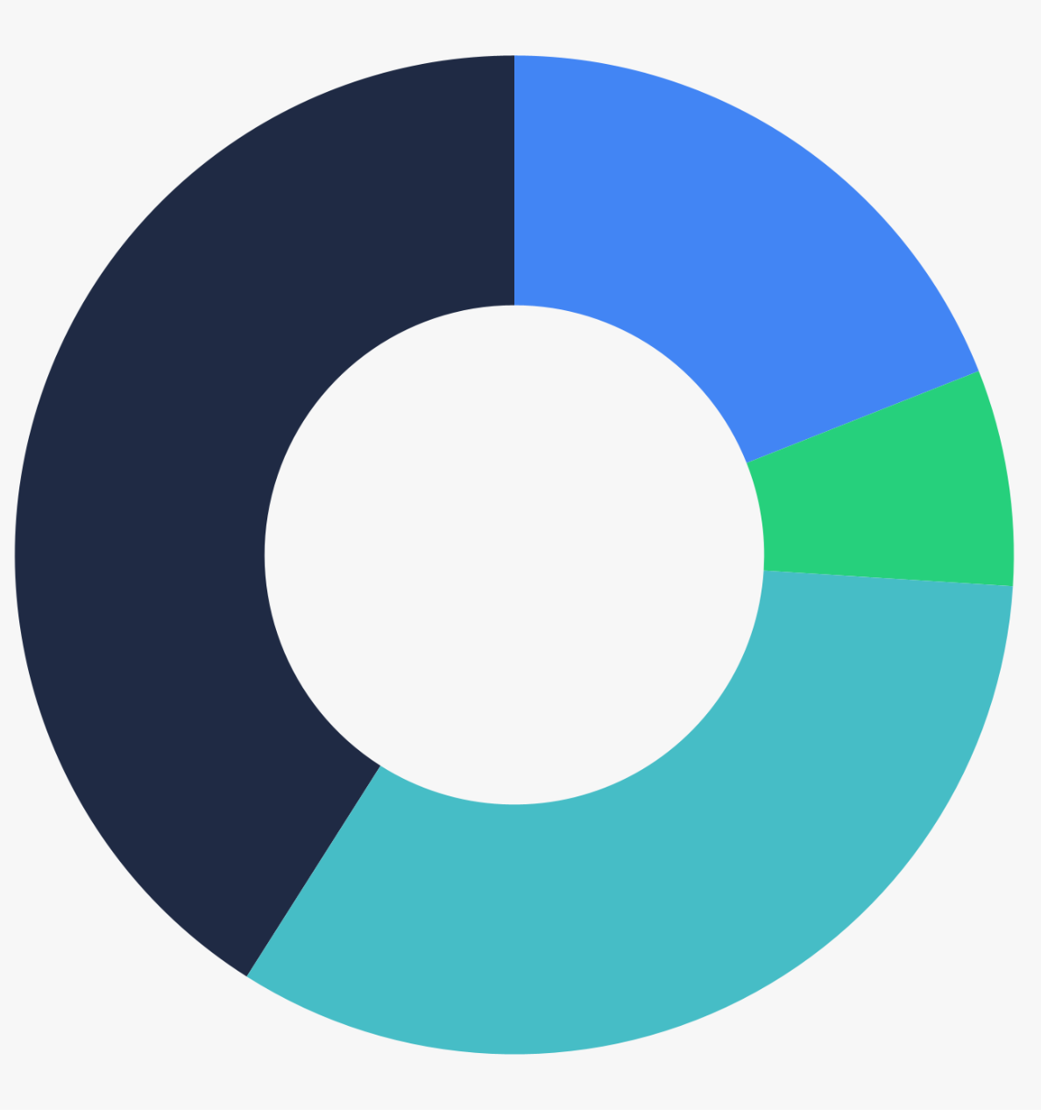
Technical use cases
How Camunda
changed the game:
Barclays replaced a legacy platform with microservices orchestrated by Camunda and now processes tens of millions of transactions daily while ensuring compliance with international banking regulations.
Orchestrate complex business processes across people, systems, and devices
Document management, scientific data processing, and other use cases
Service orchestration (including orchestration of microservices and RPA bots)
20%
39%
8%
Decision automation
Human task orchestration
33%
Survey of customer projects, n = 875
Notes:
Many of our customers have specific technical use cases that they’re working to achieve
Orchestrating human work is very common, and an area where we have a lot of experience helping companies get away from paper-based processes and leveraging automation where it makes sense
We also have many customers that are working to orchestrate microservices, RPA bots, and other technical parts of their processes
And there are plenty of companies that have projects focused on decision automation and other technical use cases that are specific to their business and their industry
Notes:
The data on this slide was last updated on 13 December 2024
Barclays story: https://camunda.com/blog/2024/12/barclays-transforms-post-trade-settlements-camunda/

Slide 104
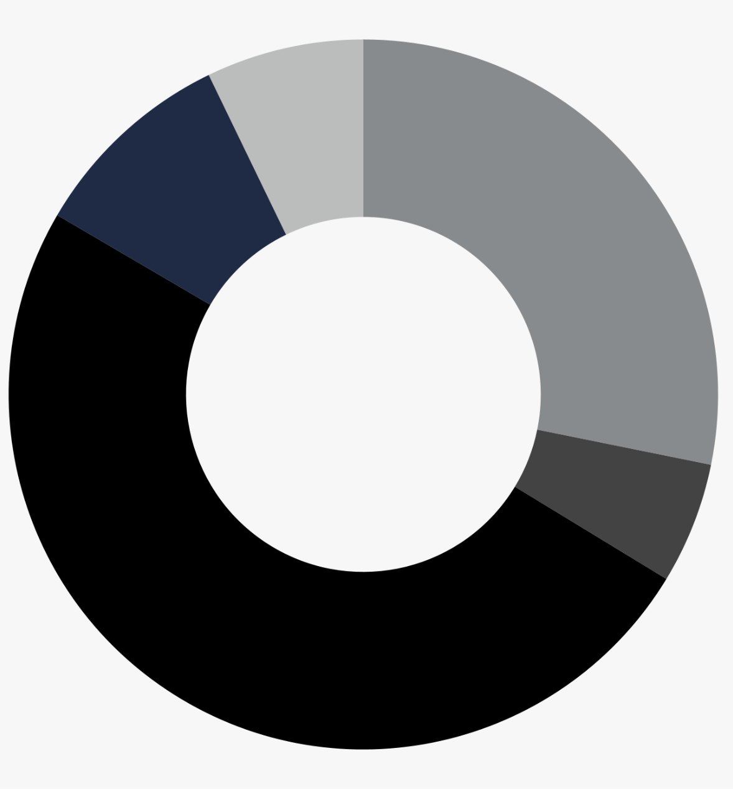
Business processes
How Camunda
changed the game:
Intuit has implemented 70+ Camunda-powered offerings for QuickBooks and TurboTax customers — including high- volume notifications, complex approval workflows, and automated tax filings in the US.
Across industries and functional groups, Camunda makes work happen
Claims management, risk management, and underwriting
10%
Loan origination
Order management
12%
9%
17%
Customer onboarding and data management
Compliance data collection, medical records management,
and other processes
52%
Survey of customer projects, n = 895
Notes:
Looking at our customers’ specific business processes, we see a few common trends around customer onboarding, management of customer data, order management, loan origination, and insurance processes such as claims management
We also have many customers that are using Camunda products to collect compliance data, safely handle sensitive data such as medical records, and many other processes, both back-office processes and customer-facing processes
Notes:
The data on this slide was last updated on 13 December 2024
Intuit story: https://camunda.com/blog/2024/08/scaling-workflow-engines-intuit-camunda-8-zeebe/

Slide 105
Miscellaneous slides
Notes:
These are additional slides that you can use as needed.

Slide 106
Camunda | Process Orchestration & Automation Platform
Traditional approach
Camunda approach
Fragmented processes
End-to-end orchestration
Proprietary tooling
Standards-based collaboration
Hard to install & extend
Developer-friendly
Black-box monoliths
Open architecture
Endless expense & maintenance
Cost-effective
Notes:
With Camunda, you can transform fragmented business processes into processes that are orchestrated from end to end
We support the use of the BPMN and DMN standards to bring all process stakeholders together to collaborate
The way we prioritize developers is unique, and we’ve found that it helps organizations automate their processes in an iterative way, which empowers developers and ultimately makes them happier and more productive
Our software is designed to integrate with any IT tooling or technical architecture that you have in place
All of this leads to a lower total cost of ownership with Camunda; that’s lower costs in terms of licensing, speed of implementation, consulting fees, and day-to-day operational costs

Slide 107
Composability at Camunda
Software delivery lens | Requires you to use proprietary source control, testing, deployment, and/or monitoring capabilities. Doesn’t work with commonly used DevOps practices or CI/CD tooling. | Works with enterprise source control, automated testing, CI/CD pipelines, system and cluster monitoring, and multiple programming languages.
Integration lens | Users can’t customize, extend, or build their own connectors easily. APIs and SDKs are missing, poorly documented, or incomplete. Workflow engine can’t be run in a headless setup, limiting options for application architecture. | Connectors can be customized and extended by both low-code and pro-code developers, and an SDK enables creation of custom connectors. Includes well-documented APIs and SDKs in multiple languages. Zeebe can run headless.
Process design lens | Process flow logic (what happens when) and task execution (how it happens) are tightly coupled. Task execution logic is hidden in a black box. Limited support for advanced workflow patterns. Process models can’t be ported to another tool. | Uses ISO-standard BPMN to decouple flow logic from task execution for flexibility, reusability, and future-proofing. Task execution logic is visible. BPMN enables all advanced workflow patterns. Supports import/export of process models.
Task automation lens | Requires you to use built-in task automation capabilities such as RPA bots and document processing features. Doesn’t support combining multiple RPA tools, IDP services, etc. Limited support for custom coding. | Use ours, use others, or mix-and-match for maximum flexibility across different departments, teams, use cases. Full support for custom code in any programming language. Helps avoid being locked in with specific tools for RPA, IDP, and other tasks.
AI/ML lens | Requires you to use built-in or pre-connected AI/ML tools such as text generators. Cannot blend deterministic and non-deterministic process execution logic. | Can orchestrate any AI/ML tool or service through pre-built and custom connectors. Supports blending deterministic and non-deterministic process execution in a single process flow.
Not composable
Camunda composability
Notes:
Composable architecture combines the principles of modularity, autonomy, orchestration, and discovery to ensure a flexible and resilient technical foundation that’s future-proof and that enables organizations to quickly capitalize on business opportunities as they arise
Composability enables companies to select and integrate best-of-breed tools, technologies, and services, so they can ensure that their process automation architecture precisely fits their business use case—instead of constantly compromising because of technology limitations
Notes:
More information https://camunda.com/blog/2024/07/why-composable-process-automation/

Slide 108
What to look for in an advanced workflow engine
Ensure your most complex, mission-critical processes run reliably, every time
Design
Runtime
Operations
Features that allow users to build, test, and deploy process and decision logic.
Features that deliver massive scale, resilience, security, and durability.
Features that make it easy to install, run, and upgrade the workflow engine.
Process logic
Advanced workflow patterns
Integrated decision logic
Process and decision versioning
Process simulation
Process testing
Long-running process management
Scalable, resilient, performant state persistence
Event/message correlation
Timers and timeouts
Payload/data
Synchronous and asynchronous endpoint integration
Open architecture
Process instance modification
Process instance migration
High availability
Uptime and upgrades
Backups
Auditability
Notes:
Notes:
More information https://camunda.com/zeebe/advanced-workflow-engine/

Slide 109
Camunda community engagement
Camunda Chapters and Meetups
Camunda Online Forum
CamundaCon Europe and North America
Camunda Local Events
Program to help community members establish and maintain Camunda Chapters that hold regular meetups
Community forum for users to ask questions, troubleshoot issues, and share best practices and lessons learned
Annual conferences for developers, enterprise architects, business technologists, and more
In-person and events for Camunda users, partners, and open source contributors to connect with one another
Camunda Community Hub
Camunda Champion Program
Camunda Educational License Program
Camunda for Common Good
GitHub organization for open source Connectors and extensions contributed by community members
Year-long program that recognizes our most passionate community members and contributors
Enterprise license for educational institutions for the purpose of teaching or academic research
Special software license and support for NGOs and nonprofits that can benefit from process orchestration
Notes:
There’s an active global community of Camunda users and developers; they hold regular meetups, contribute to our online forum, and more
We recognize our most active contributors through the Camunda Champion Program
And we offer special licenses to the community through our Educational License Program and Camunda for Common Good
Links to share with the audience, if requested:
Camunda Chapters and Meetups: https://community.camunda.com/
Camunda Platform Forum: https://forum.camunda.io/
CamundaCon: https://camundacon.com
CamundaLocal events: https://camunda.com/events/upcoming/?type=camunda-local
Camunda Community Hub: https://github.com/camunda-community-hub
Camunda Champion Program: https://camunda.com/developers/champions/
Camunda Educational License Program (CELP): https://camunda.com/educationee/
Camunda for Common Good: https://camunda.com/common-good/

Slide 110
Change log
Date | Change | Date | Change
3 March 2025 | Added “Roadmap to operationalizing AI” slides
7 March 2025 | Updated the product slide (#9) with more AI focus and AI Agents under Modeler, also new look.
11 March 2025 | Added IDP infrastructure diagram
3 April 2025 | Replaced the “platform stack” slide with a new version using the new Camunda AI symbol and colors; added two slides about agentic orchestration
16 April 2025 | Removed the Camunda SaaS Starter Edition (SaaS is now only available in Free and Enterprise Editions)
6 May 2025 | Added one new slide about how Camunda delivers agentic orchestration

Slide 111
Camunda | Operationalize AI with Camunda
AI enabled
Process Orchestration & Automation Platform
Design & Implement
Test & Deploy
Automate
Improve
Developers & business users collaborate to design processes, decisions, and forms.
Developers & testers ensure the end-to-end process is working as intended.
Enterprise-grade automation. Built for today’s business complexity, loved by developers.
Teams have the insights to fix the highest ROI problems for business processes.
Modeler
Rapid Process Testing
Zeebe Workflow & Decision Engine
Optimize
Design BPMN process models and DMN decision tables, assisted by with AI Copilots.
Simulate processes without affecting production systems and deploy with confidence.
Cloud-native event streaming for unparalleled scale and resilience.
Monitor KPIs and analyze performance with one model for visualization.
Integrated AI Agents
Workers
Model, deploy & manage AI agents alongside process models.
CI/CD Integration
AI agents, connectors, RPA, document handling, IDP, and custom workers.
Forms
Accelerate time-to-market by integrating with your SDLC ecosystem.
Drag & drop UI builder to capture data and guide user interactions across your processes.
Operate
IDP
Manage and troubleshoot processes with one model for management.
Ingest, digitize, & process documents with AI to increase productivity and improve experiences.
RPA
Tasklist
Integrated RPA helps bridge the gap between legacy & AI for applications lacking API connectivity.
Web app for tasks that must be handled by knowledge workers.
Connectors & Marketplace
Integrate and operationalize connectivity all systems and LLMs.
Manage
Console
Identity
Enterprise SSO
Extend
Manage clusters and API keys, review audit logs, and perform one-click upgrades.
Manage applications, APIs, users, and roles.
SSO
Enterprise single sign-on for consistent authentication and secure user access across your entire organization.
End-to-end governance of your Camunda installation.
Complete library of SDKs and APIs to integrate and extend process applications.
Notes:
Camunda’s process orchestration and automation platform supports the entire lifecycle of process improvement
Camunda has intelligently integrated and enabled AI into its platform - helping organizations to operationalize AI across their enterprise
Camunda’s AI-enabled platform means users can design, deploy, automate, optimize, and govern their processes with greater intelligence, adaptability, and control.
More details
Design & Implement: developers and business users collaborate to design processes, decisions, and forms - assisted by with AI Copilots.
Test & Deploy: Developers and testers ensure the end-to-end process is working as intended
Automate: Enterprise-grade automation, built for today’s business complexity, loved by developers. Automate your processes with AI agents, connectors, RPA, document handling, IDP, and custom workers.
Improve: With Optimize, leadership and teams can monitor KPIs and analyze performance with one model for visualization. This gives you critical visibility and oversight across all your processes and around AI Agents.
Managed: Full governance over your installation and usage

Slide 112
From idea to production with total control
Executable BPMN. Event-driven runtime. Built-in transparency.
Controlled flexibility with modeled agent handoffs
Dynamic flows
AI Agent
Multi-agent orchestration
Coordinate multiple agents with runtime routing logic
Deterministic flows
Consistent experience and policy adherence
+
Agents orchestrates subprocesses
Trigger subprocesses autonomously
Event-driven
response
Waits, listens, and reacts no matter how long it takes
Bring humans in the loop when necessary
Escalation to humans
Notes:
Reinforce Deterministic + Dynamic together (+ agents calling entire subprocesses which offers additional level of control and flexibility)
Escalating based on data
Responding to events in real time
Calling other agents or processes as needed.
Adaptive Control: That subworkflow can feed data to the next LLM loop, interrupt current tools, or even terminate the agent if needed.
Existing talk track: Agents orchestrates subworkflow
Subworkflow Concept: Agents can trigger and oversee complete subprocesses, not just single tasks.
Scalable Tooling: A “tool” can be a full BPMN flow, accommodating complex or multi-step activities effortlessly.
Customer Support Example: While handling a support request, the agent launches a dedicated “Diagnostics Subworkflow” to gather more info. This automated orchestration ensures faster resolutions and a premium customer experience.
Agents pivot instantly with external messages and timers.
Dynamic Interaction: During execution, agents can be influenced by events like external messages or timers, enabling on-the-fly adjustments.
Agile Process Flow: Seamless adaptation to new information or urgent signals prevents wasted effort.
Customer Support Example: An agent is midway through resolving a ticket when an external message confirms a related ticket was solved by a colleague. The agent immediately concludes
Multi Agent Orchestration
Nested Logic: Agents can embed and manage other agents, creating a robust multi-agent architecture.
Flexible Tools: A “tool” itself can be another agent, simplifying delegation of complex tasks.
Customer Support Example: A primary agent delegates advanced troubleshooting to a specialized support agent, accelerating issue resolution and elevating service quality.
Event-Driven Agent Reconfiguration
Flexibility: Incoming messages spawn a subworkflow that interprets new information.
Adaptive Control: That subworkflow can feed data to the next LLM loop, interrupt current tools, or even terminate the agent if needed.
Customer Support Example: While an agent is processing a return request, an external “Order Canceled” event arrives. A subworkflow updates the LLM with the latest status, halts unnecessary tasks, and promptly completes the agent’s flow to reflect the cancellation.

Slide 113
Mixing Agents with Workflow patterns
Camunda agent
+
Deterministic flows
Full control of process actions to balance compliance, consistency, and flexibility with ad-hoc sub-processes.
Dynamic flows
Autonomous agent determines what happens as the process runs, using AI models, internal policies, and real-time process data.
Agents orchestrates subworkflow
Tools can be single system or call an entire subprocess.
Humans in the Loop
Ensure agents request human intervention when their confidence level is low or more data is needed
Event-Driven Response
Autonomous structure for agents to respond to events, external messages or timers to guide the next AI steps.
Multi-Agent Orchestration
Agents orchestrate other agents for streamlined, scalable solutions.
Notes:
Agents orchestrates subworkflow
Subworkflow Concept: Agents can trigger and oversee complete subprocesses, not just single tasks.
Scalable Tooling: A “tool” can be a full BPMN flow, accommodating complex or multi-step activities effortlessly.
Customer Support Example: While handling a support request, the agent launches a dedicated “Diagnostics Subworkflow” to gather more info. This automated orchestration ensures faster resolutions and a premium customer experience.
Agents pivot instantly with external messages and timers.
Dynamic Interaction: During execution, agents can be influenced by events like external messages or timers, enabling on-the-fly adjustments.
Agile Process Flow: Seamless adaptation to new information or urgent signals prevents wasted effort.
Customer Support Example: An agent is midway through resolving a ticket when an external message confirms a related ticket was solved by a colleague. The agent immediately concludes
Multi Agent Orchestration
Nested Logic: Agents can embed and manage other agents, creating a robust multi-agent architecture.
Flexible Tools: A “tool” itself can be another agent, simplifying delegation of complex tasks.
Customer Support Example: A primary agent delegates advanced troubleshooting to a specialized support agent, accelerating issue resolution and elevating service quality.
Event-Driven Agent Reconfiguration
Flexibility: Incoming messages spawn a subworkflow that interprets new information.
Adaptive Control: That subworkflow can feed data to the next LLM loop, interrupt current tools, or even terminate the agent if needed.
Customer Support Example: While an agent is processing a return request, an external “Order Canceled” event arrives. A subworkflow updates the LLM with the latest status, halts unnecessary tasks, and promptly completes the agent’s flow to reflect the cancellation.

Slide 114
Drive automation with agentic process orchestration
Blend deterministic and non-deterministic (agent-powered) orchestration to ensure guardrails are in place
Agent
~
Notes:
An AI agent is an application that can act independently of people to achieve a specific goal
Agents are ideal for increasing the level of automation in processes where the exact steps aren’t known beforehand (such as case management scenarios)
However, agents don’t produce predictable, repeatable results, which can be a challenge for organizations in highly regulated industries
Camunda allows you to blend deterministic orchestration (via BPMN) with non-deterministic orchestration (via agents) so you can implement as much or as little AI as you want within guardrails
More information:
AI-enabled process orchestration (webpage)
Why AI Agents Need Orchestration (blog post)
Operationalize AI by Blending Deterministic and Non-Deterministic Process Orchestration (blog post
Build Your First AI Agent in Camunda (step-by-step tutorial)

